Slide 1
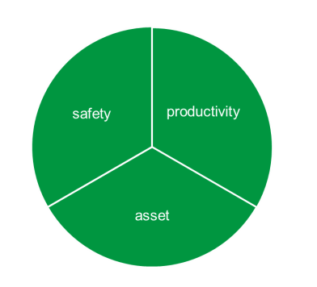
Compliance Update Brett Patterson, Principal Manager, Enforcement Operations

Slide 2
The Compliance Task!
The purpose of Roads and Maritime is to enable safe and efficient journeys throughout NSW
Divisional focus is to become an agile, risk-based and outcomes focused regulator.
This means our regulatory policies, practices, systems and processes need to be aligned with today’s modern environment and be flexible to support future changes in the transport landscape.
In striving to achieve this purpose Roads and Maritime are engaging with industry and where required targeting non complying operators and associated parties within the chain of responsibility.

Slide 3
Compliance Inspections
2015/2016 heavy vehicle inspections included:
On-road enforcement: 60, 794 (98,974 units)
Heavy Vehicle Safety Stations: 121,165 intercepts (226,617 units)
Inter Agency: 66,365 (121,288 units)
Heavy Vehicle Inspection Stations: 93,132
TOTAL over 542,000 units inspected through all our safety road enforcement campaigns.

Slide 4
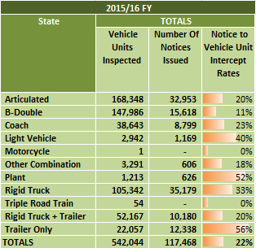
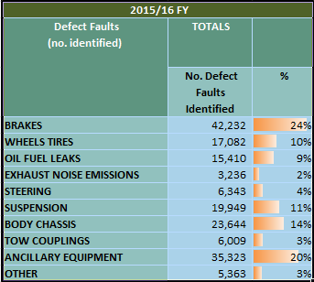
2015/2016
Vehicle category and key defects identified

Slide 5
State-trans 2016

Slide 6
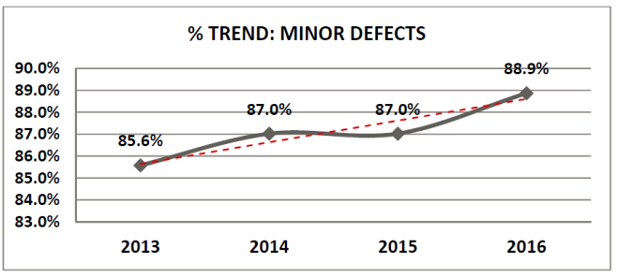
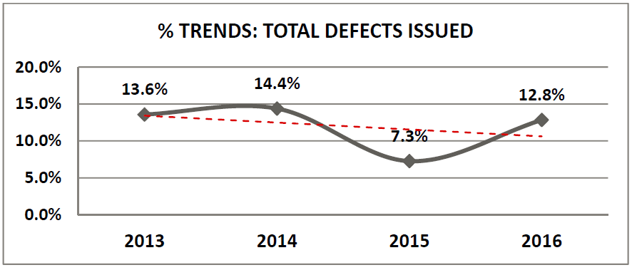
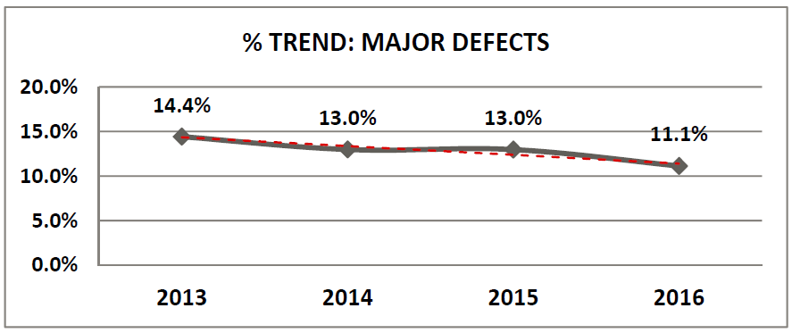
State-trans Defect notices

Slide 7
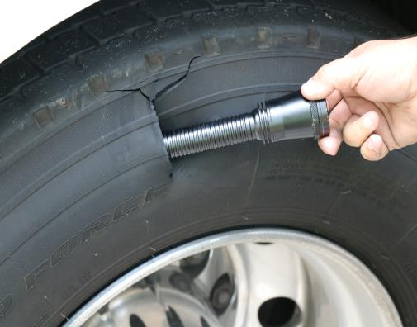
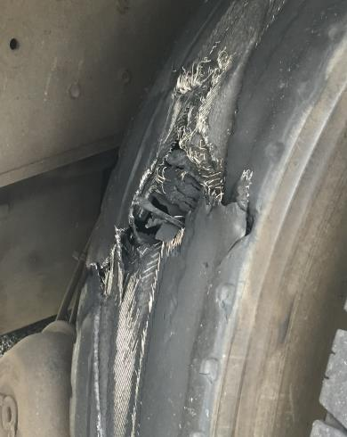
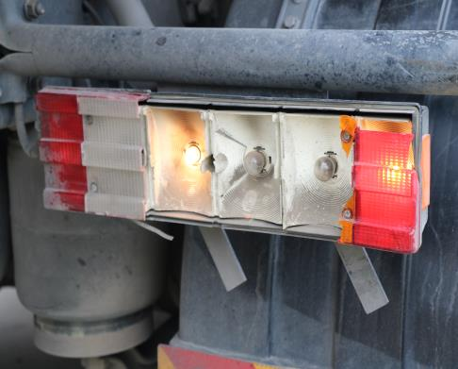
Poor fleet maintenance
Notes:
Poor maintenance is another factor, with these trucks delivering into Distribution Centres, having travelled some distance in poor repair, all signficant road safety risks

Slide 8
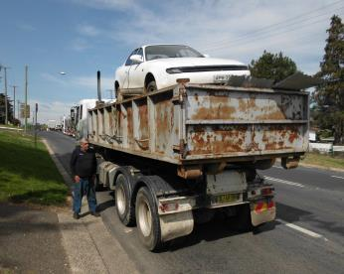
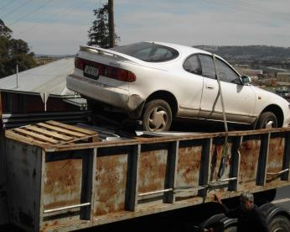
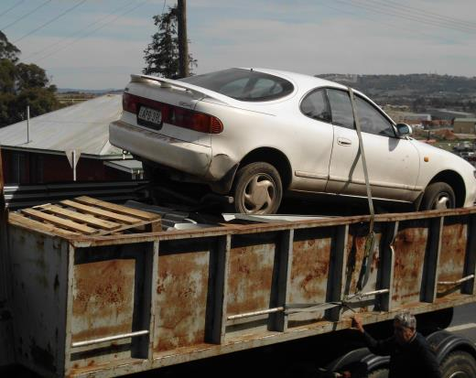
Access and loading

Slide 9
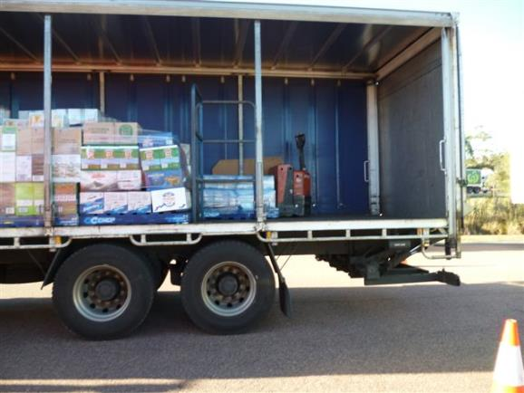
Poor loading

Slide 10
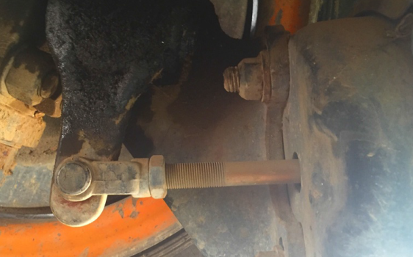
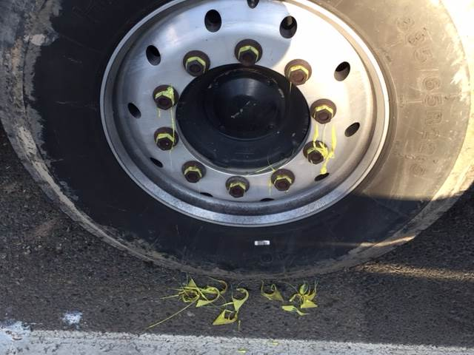
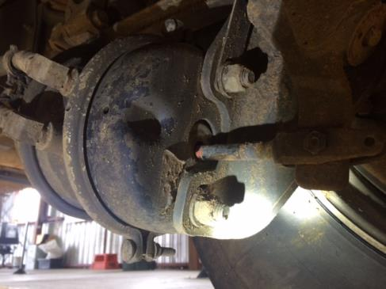
Brakes
Melt Temperature:
125°C (standard)
165°C (high temperature)
203°C (ultra high temperature)

Slide 11
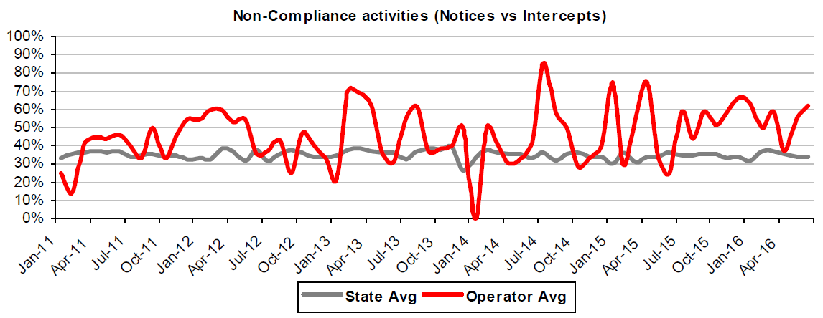
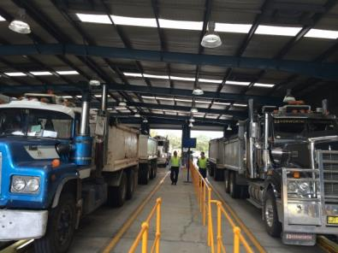
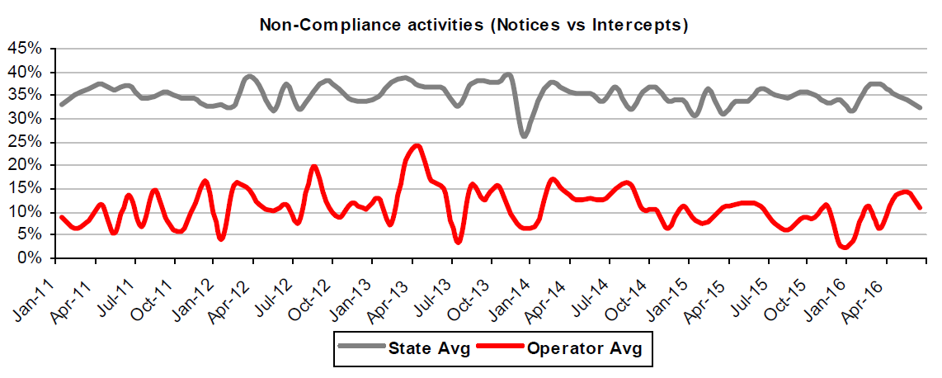
Operator profiling
Notes:
2015 Total Intercepts: 1237 Total Units Inspected 3228
2016 to 1 August Total Intercepts: 638 Total Units Inspected 1704

Slide 12
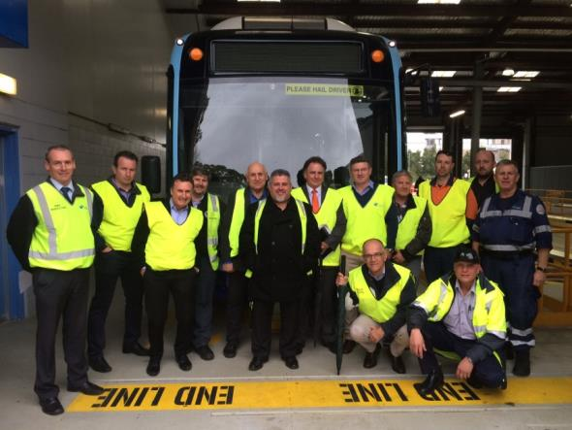
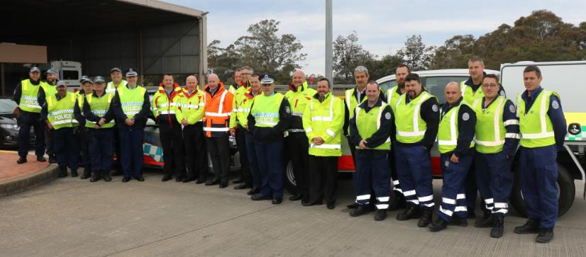
Engagement and education
Heavy vehicle operators visit
to Marulan Heavy Vehicle Safety Station
BUSNSW and Bus operators visit to RMS inspection site

Slide 13
DG Industry Inspections 2013
Late 2013/14
Of the 366 units inspected;
47 % passed inspections (172 units)
7% Formal Warning Notices (26 units)
30% minor defect notices (109 units)
15% major defect notices (56 units)
1% Major GROUNDED defect notices (3 units)

Slide 14
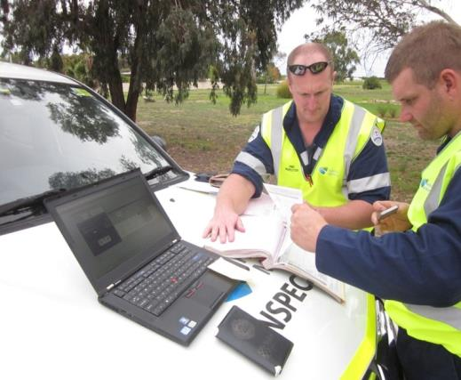
2015 DG Compliance Monitoring
June 2015
Of the 54 units inspected;
78 % pass inspections (42 units)
16% minor defect notices (9 units)
3% major defect notices (2 units)
3% Major GROUNDED defect notices (2 units)

Slide 15
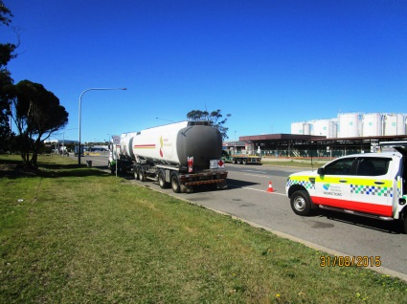
2016 DG Compliance Monitoring
July 2016
Of the 98 units inspected in summary the results were:
86 % units defect free (84 units)
13% Minor defects (13 units)
> 1% Major defect (1 unit)
0 Major Grounded defects

Slide 16
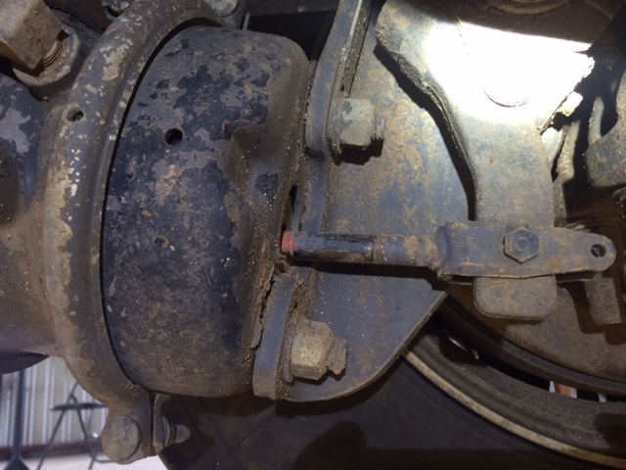
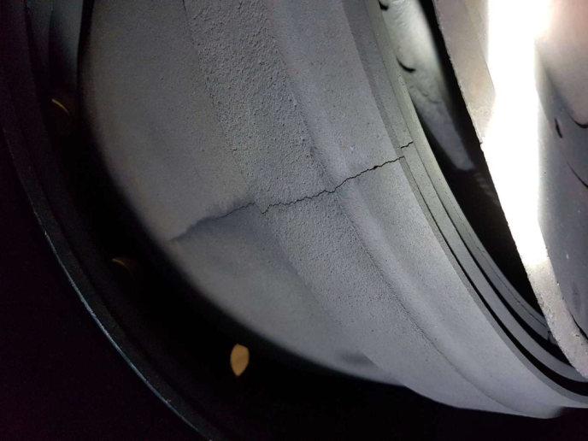
Dangerous goods vehicle
Brakes

Slide 17
We are here to help
Heavy Vehicle Hotline
1300 STOP HV
(1300 786 748)

