Slide 1
National Heavy Vehicle Inspection Manual &
Roadworthiness Program
Daniel Elkins, Director Safety
Bulk Tanker Day, Sydney 15 September 2016
National Heavy Vehicle Regulator

Slide 2
History of the NHVIM
Model document developed by the NTC in 2003 and reviewed in 2004
Each jurisdiction created a version, with variations
Initial NHVR review in 2014 produced NHVIM v1
Comprehensive review in 2015 produced NHVIM v2
Implemented in all participating jurisdictions from 1 July 2016.

Slide 3
Review process
Request from Ministers in 2014 to review and agreement to adopt nationally
Section by section review
Wide consultation with industry and jurisdictions
Subject matter expert input
Run over 12 months
Finalised December 2015
Implemented from 1 July 2016

Slide 4
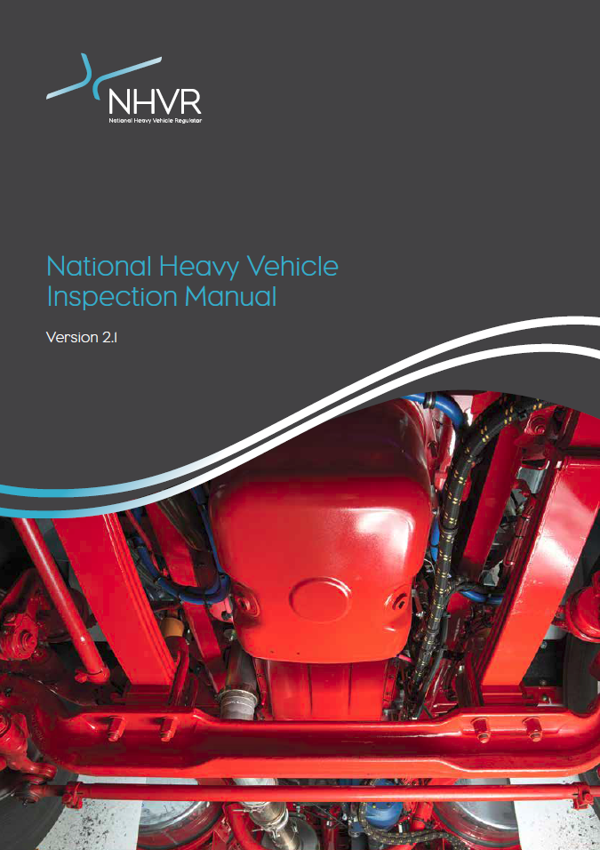
NHVIM Version 2
New modern look
National standard for heavy vehicle roadworthiness inspections
National ‘dictionary’ for vehicle defects
Openly published to provide transparency

Slide 5
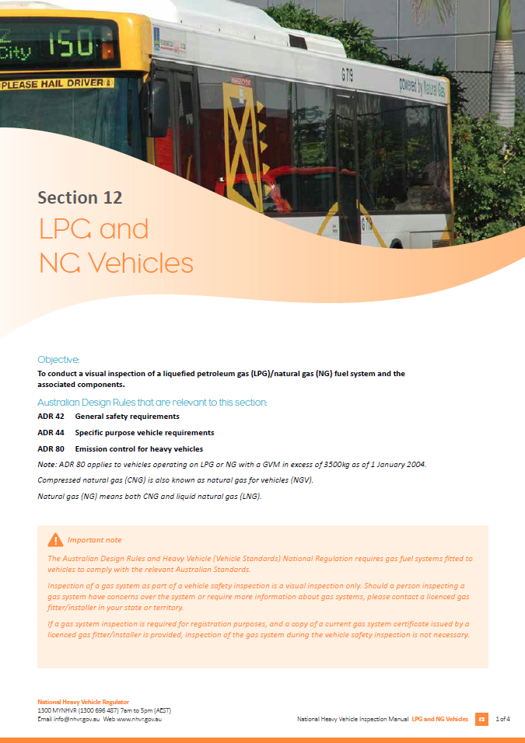
What has changed
Better alignment of ‘Reasons for rejection’ with ADRs and Regulation
New diagrams to assist understanding
New sections for Motorhomes (Section 15) and Vehicle Dimensions (Section 16)
Simplified requirements for gas systems (Section 12)

Slide 6
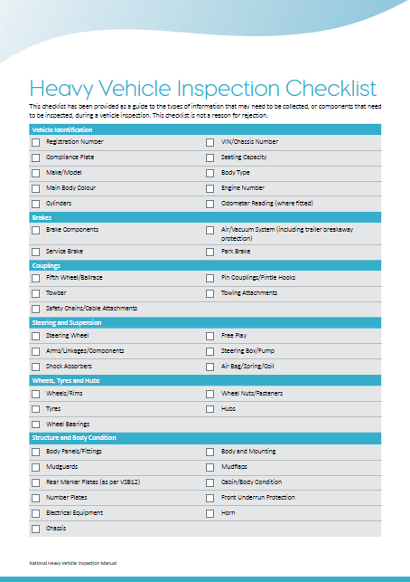
Using the manual
Vehicle examiners performing roadworthiness inspections
Basis for issuing defect notices by Authorised Officers
Maintenance system for vehicle operators
Standard for the National Roadworthiness Baseline Survey in August – September 2016

Slide 7
Keeping current
NHVIM is a live document on a 2-3 year review cycle
NHVR will make routine minor updates regularly
In consultation with industry and subject matter experts
Feedback welcomed via form on the NHVR website
www.nhvr.gov.au/nhvim
Next scheduled update in late 2016
Review of Section 2 Brakes
General updates based on feedback
Subsequent reviews will be aligned to HVNL amendments

Slide 8
National Heavy Vehicle
Roadworthiness Program
Initiated by responsible Ministers in 2014
Objectives:
to increase the safety of heavy vehicles by changing operator behaviour to encourage a proactive maintenance culture
Nationally consistent heavy vehicle roadworthiness framework
Adopt a risk-based approach, based on evidence, for auditing, monitoring and inspecting heavy vehicles

Slide 9
National Heavy Vehicle
Roadworthiness Program
8 projects to develop a national approach to roadworthiness:
Review of the National Heavy Vehicle Inspection Manual
National roadworthiness baseline survey
Roadworthiness data collection
Roadworthiness criteria
Inspection types
Inspection competency standards
Management and clearance of defects
Risk-based inspection criteria

Slide 10
National Heavy Vehicle
Roadworthiness Program
Review of the NHVIM
Single national standards for inspections
National roadworthiness baseline survey
Health check of the heavy vehicle fleet nationally
August & September 2016
Provide evidence for risk-based approach to vehicle safety
Roadworthiness data collection
Identify and collect data that gives evidence to make risk-based decisions about inspections

Slide 11
National Heavy Vehicle
Roadworthiness Program
Roadworthiness criteria
Defining when a defect makes a vehicle unsafe to be used on a road
Inspection types
Nationally consistent inspection requirements (items to check, inspection methodology, facility and equipment requirements)

Slide 12
National Heavy Vehicle
Roadworthiness Program
Inspection competency standards
Nationally consistent inspector competency requirements
Matched to inspection type
Management and clearance of defects
Consistent classification of defects (levels, clearance methods etc)
Risk-based inspection criteria
Structure of inspections (what vehicles, when inspected, what is inspected) based on risk

Slide 13
Questions?

Slide 14
Contact Information
Daniel Elkins
Director Safety
07 3309 8543
daniel.elkins@nhvr.gov.au
Peter Austin
Manager (Vehicle Safety and Performance)
07 3309 8561
peter.austin@nhvr.gov.au

