Slide 1
The Case for Mandating ESC + RSP in Australia
Dr Peter Hart,
Chairman ARTSA

Slide 2
Conclusions
ESC with roll-stability might reduce fatal HV crash rates by 30% + if installed on all HVs.

Slide 3
Conclusions
ESC with roll-stability might reduce fatal HV crash rates by 30% + if installed on all HVs.
The future is clear. It involves ESC on new prime-movers and probably on new trailers.

Slide 4
Conclusions
ESC with roll-stability might reduce fatal HV crash rates by 30% + if installed on all HVs.
The future is clear. It involves ESC on new prime-movers and probably on new trailers.
The ADR rule making process has failed.

Slide 5
Conclusions
ESC with roll-stability might reduce fatal HV crash rates by 30% + if installed on all HVs.
The future is clear. It involves ESC on new prime-movers and probably on new trailers.
The ADR rule making process has failed.
Without high level intervention, Australia will continue to dilly-dally.

Slide 6
Conclusions
ESC with roll-stability might reduce fatal HV crash rates by 30% + if installed on all HVs.
The future is clear. It involves ESC on new prime-movers and probably on new trailers.
The ADR rule making process has failed.
Without high level intervention, Australia will continue to dilly-dally.
Premier Napthine should announce that post 1 Jan 2016, new HVs in Victoria must have ESC (including RSP)

Slide 7
Context
‘Stable’ braking is fundamentally important for road safety.

Slide 8
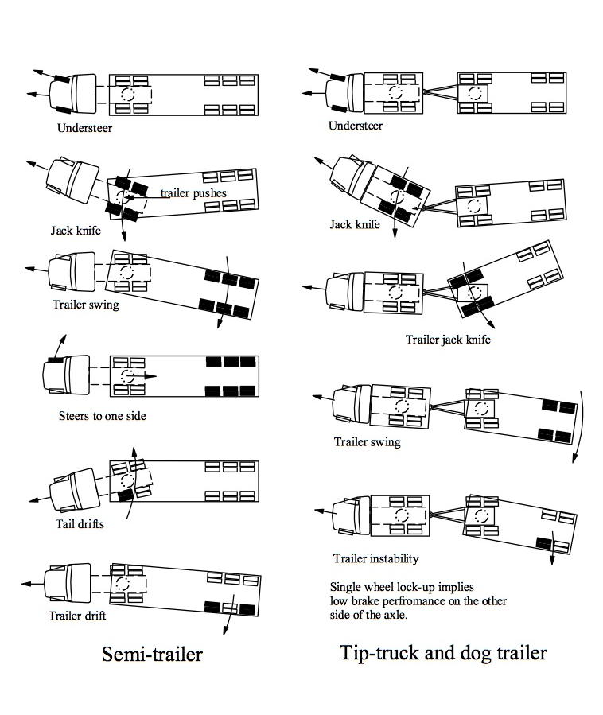

Slide 9
Context
‘Stable’ braking is fundamentally important for road safety.
We can learn from overseas experience.

Slide 10
Context
‘Stable’ braking is fundamentally important for road safety.
We can learn from overseas experience.
We should learn from our experience.

Slide 11
Context
‘Stable’ braking is fundamentally important for road safety.
We can learn from overseas experience.
We should learn from our experience.
Our industry should be making continuous improvement in safety performance.

Slide 12
Fatal HV Crashes to June ‘12

Slide 13
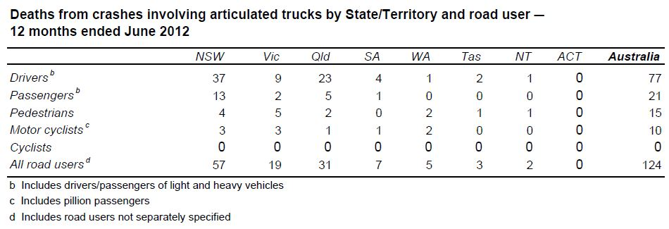
Fatal HV Crashes to Sept ‘11

Slide 15
NTI – HV Crash Causation (2012)

Slide 16
NTI – HV Crash Causation (2012)
About 30 % of crashes would have benefited from ESC + roll stability
About 25 % of fatal crashes would have benefited from ESC + roll stability

Slide 17
NTI – HV Crash Causation (2012)
About 30 % of crashes would have benefited from ESC + roll stability
About 25 % of fatal crashes would have benefited from ESC + roll stability

Slide 18
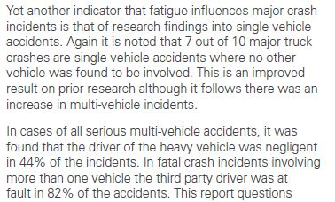
NTI – HV Crash Causation (2011)

Slide 19
Victoria – HV Crash Causation (2012)
About 25 % of fatal crashes would have benefited from ESC + roll stability

Slide 20
Victoria – HV Crash Causation (2012)
About 25 % of fatal crashes would have benefited from ESC + roll stability

Slide 21
First - Some Basics
Drum brakes dominate the Australian HV scene.
Stopping performance is limited by brake balance rather than brake capacity. This is especially so for combinations.
Balanced braking occurs when all wheels contribute retardation force in proportion to the load they carry.
Trucks and trailers are routinely reconfigured.
Prime-movers experience a laden : unladen weight variation of ~ 2:1. For trailers the ratio is > 3:1.

Slide 22
A Short History of Australian HV Braking Practice
Late 1980’s – TNT agitated for improved combination brake performance (Close, Solomon & McManus)
Slow timing, poor balance and bad valve choices
were cited.
1 July 1988 – ADR 35/01 applies to trucks.
Performance is still 3.78 m/s² from 100 km/h
Laden compatibility test introduced, which was adopted from ECE R13 v5.

Slide 23
Australian Compatibility Limits

Slide 24
ECE

Slide 25
ECE

Slide 26
ECE

Slide 27
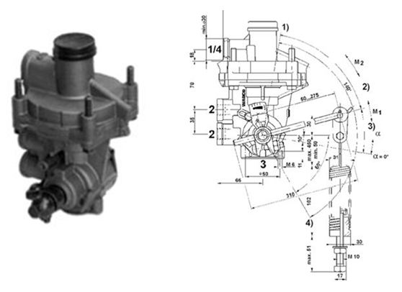
Load Sensing Valves
For spring-suspensions

Slide 28
Load Sensing Brakes in Australia
ADR 38/01
We got it completely wrong !

Slide 29
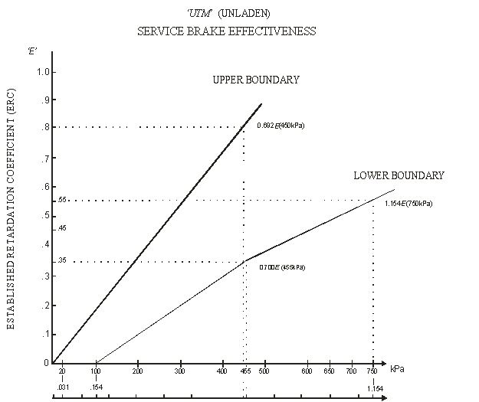
Load Sensing Brakes in Australia

Slide 30
A Short History of Australian HV Braking Practice
1991 – B-Double Federal Interstate Regulations.
ABS mandated on B-double trucks and trailers
Subsequent backlash against ABS requirement on trailers.

Slide 31
A Short History of Australian HV Braking Practice
1991 – B-Double Federal Interstate Regulations.
ABS mandated on B-double trucks and trailers
Subsequent backlash against ABS requirement on trailers.
- ABS dropped as a requirement for B-Double trailers –
except for DG tankers.

Slide 32
A Short History of Australian HV Braking Practice
1991 – B-Double Federal Interstate Regulations.
ABS mandated on B-double trucks and trailers
Subsequent backlash against ABS requirement on trailers.
- ABS dropped as a requirement for B-Double trailers –
except for DG tankers.
2007 – Unladen compatibility requirements in ADRs 35 & 38
only when LSVs are fitted.

Slide 33
International Developments
1991 – ECE R13 drops unladen brake compatibility requirements for vehicles with ABS installed.
ABS mandated on new trucks and trailers.

Slide 34
International Developments
1991 – ECE R13 drops unladen brake compatibility requirements for vehicles with ABS installed.
ABS mandated on new trucks and trailers.
1991 – Introduction of ABS for heavy vehicles in Europe.

Slide 35
International Developments
1991 – ECE R13 drops unladen brake compatibility requirements for vehicles with ABS installed.
ABS mandated on new trucks and trailers.
1991 – Introduction of ABS for heavy vehicles in Europe.
1997 – USA mandates Antilock brakes on new trucks and trailers.
Reintroduces stopping distance requirements.
No effective compatibility limits.

Slide 36
International Developments

Slide 37
International Developments

Slide 38
International Developments

Slide 39
International Developments

Slide 40
A Short History of Australian HV Braking Practice
Early 2000’s – Introduction of disc brakes and advanced electronic brake controls on European trucks. Quantum
improvements.

Slide 41
A Short History of Australian HV Braking Practice
Early 2000’s – Introduction of disc brakes and advanced electronic brake controls on European trucks. Quantum
improvements.
2003 - report to NRTC
“An Investigation into Heavy Vehicle Brake Innovations”

Slide 42
A Short History of Australian HV Braking Practice
Early 2000’s – Introduction of disc brakes and advanced electronic brake controls on European trucks. Quantum
improvements.
Late 2000+ - Fuel haul industry adopts EBS on new trucks and tanker trailers.

Slide 43
A Short History of Australian HV Braking Practice
Early 2000’s – Introduction of disc brakes and advanced electronic brake controls on European trucks. Quantum
improvements.
Late 2000+ - Fuel haul industry adopts EBS on new trucks and tanker trailers.
2007 - National Heavy-Vehicle Brake Strategy Released

Slide 46
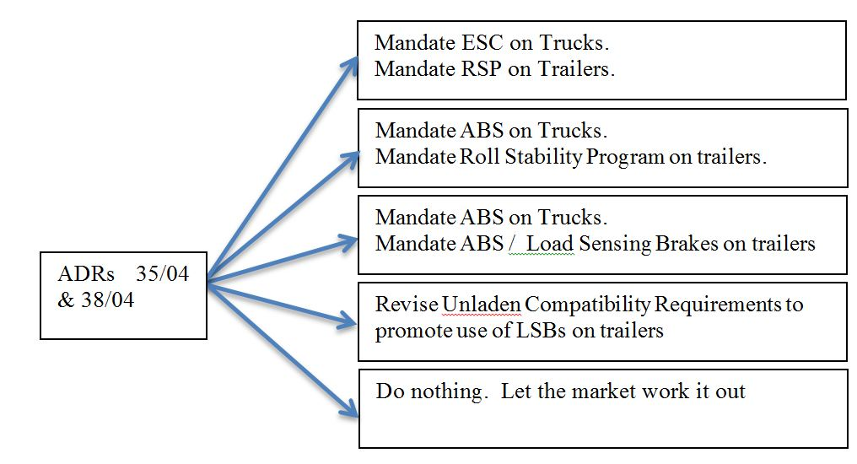
Current ADR 35 & 38 Proposals

Slide 47
Cattle Truck Rollovers

Slide 48
Cattle Truck Rollovers

Slide 49
Milk Tanker Rollovers

Slide 50
Milk Tanker Rollovers

Slide 51
Opportunities
Electronic brake technologies could produce quantum (30%) improvements in controlled stopping performance and directional control - (> 0.6g for singles and > 0.4g for combinations).

Slide 52
Issues for Australia
Electronic brake technologies could produce quantum (30%)improvements in controlled stopping performance and directional control - (> 0.6g for singles and > 0.4g for combinations).
There are currently no internationally-agreed performance standards for heavy-vehicle ESC.

Slide 53
What is an ESC ?
Mandated Features of ESC (truck) as per ECE R13 V9:
Ability to control engine power
Ability to identify and to respond to unintended lateral motion.
Ability to autonomously apply the service brakes on a
trailer.
What is not mandated in Euro ESC ?
Ability to identify and to respond to roll-over motion.

Slide 54
Issues for Australia
Electronic brake technologies could produce quantum (30%) improvements in controlled stopping performance and directional control - (> 0.6g for singles and > 0.4g for combinations).
There are currently no internationally-agreed performance standards for heavy-vehicle ESC.
When ESC is used on one part, as a minimum the other parts should have ABS.

Slide 55
Issues for Australia
Electronic brake technologies could produce quantum (30%) improvements in controlled stopping performance and directional control - (> 0.6g for singles and > 0.4g for combinations).
There are currently no internationally-agreed performance standards for heavy-vehicle ESC.
When ESC is used on one part, as a minimum the other parts should have ABS.
Mandated ABS is a potential stepping stone to ESC + RSP.

Slide 56
Issues for Australia
Trailer ‘ESC’ in Australia is EBS + roll-stability. The safety benefits of Trailer ESC are now proven.

Slide 57
Issues for Australia
Trailer ‘ESC’ in Australia is EBS + roll-stability. The safety benefits of Trailer ESC are now proven.
ESC on the truck only may be problematical because the trailer probably has no ABS protection.

Slide 58
Conclusions
ESC with roll-stability might reduce fatal HV crash rates by 30% + if installed on all HVs.

Slide 59
Conclusions
ESC with roll-stability might reduce fatal HV crash rates by 30% + if installed on all HVs.
The future is clear. It involves ESC on new prime-movers and probably on new trailers.

Slide 60
Conclusions
ESC with roll-stability might reduce fatal HV crash rates by 30% + if installed on all HVs.
The future is clear. It involves ESC on new prime-movers and probably on new trailers.
The ADR rule making process has failed.

Slide 61
Conclusions
ESC with roll-stability might reduce fatal HV crash rates by 30% + if installed on all HVs.
The future is clear. It involves ESC on new prime-movers and probably on new trailers.
The ADR rule making process has failed.
Without high level intervention, Australia will continue to dilly-dally.

Slide 62
Conclusions
ESC with roll-stability might reduce fatal HV crash rates by 30% + if installed on all HVs.
The future is clear. It involves ESC on new prime-movers and probably on new trailers.
The ADR rule making process has failed.
Without high level intervention, Australia will continue to dilly-dally.
Premier Napthine should announce that post 1 Jan 2016, new HVs in Victoria must have ESC (including RSP)

