Slide 1
Emergency Response
Safety Performance of PBS/Innovative Combinations
Les Bruzsa (NHVR) – PBS Scheme Administrator
SPONSORS
Road Transport Trends > Safer, more productive transport

Slide 2
Evolution of combinations
Early 90’s: B-doubles
1995: AB-triple
1997: B-triple
1998: ICON
1998-2004: Innovative road trains (quads)
2005-2007 – PBS type combinations
2008: PBS
freightweek.com.au
Road Transport Trends > Safer, more productive transport

Slide 3
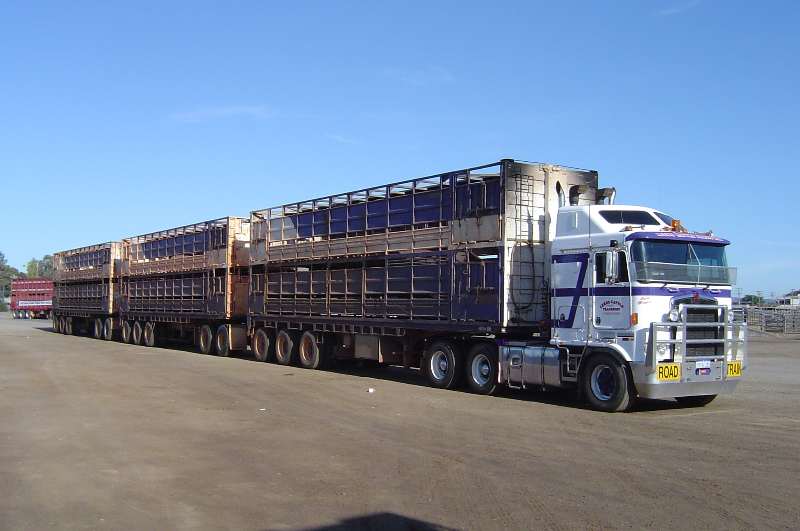
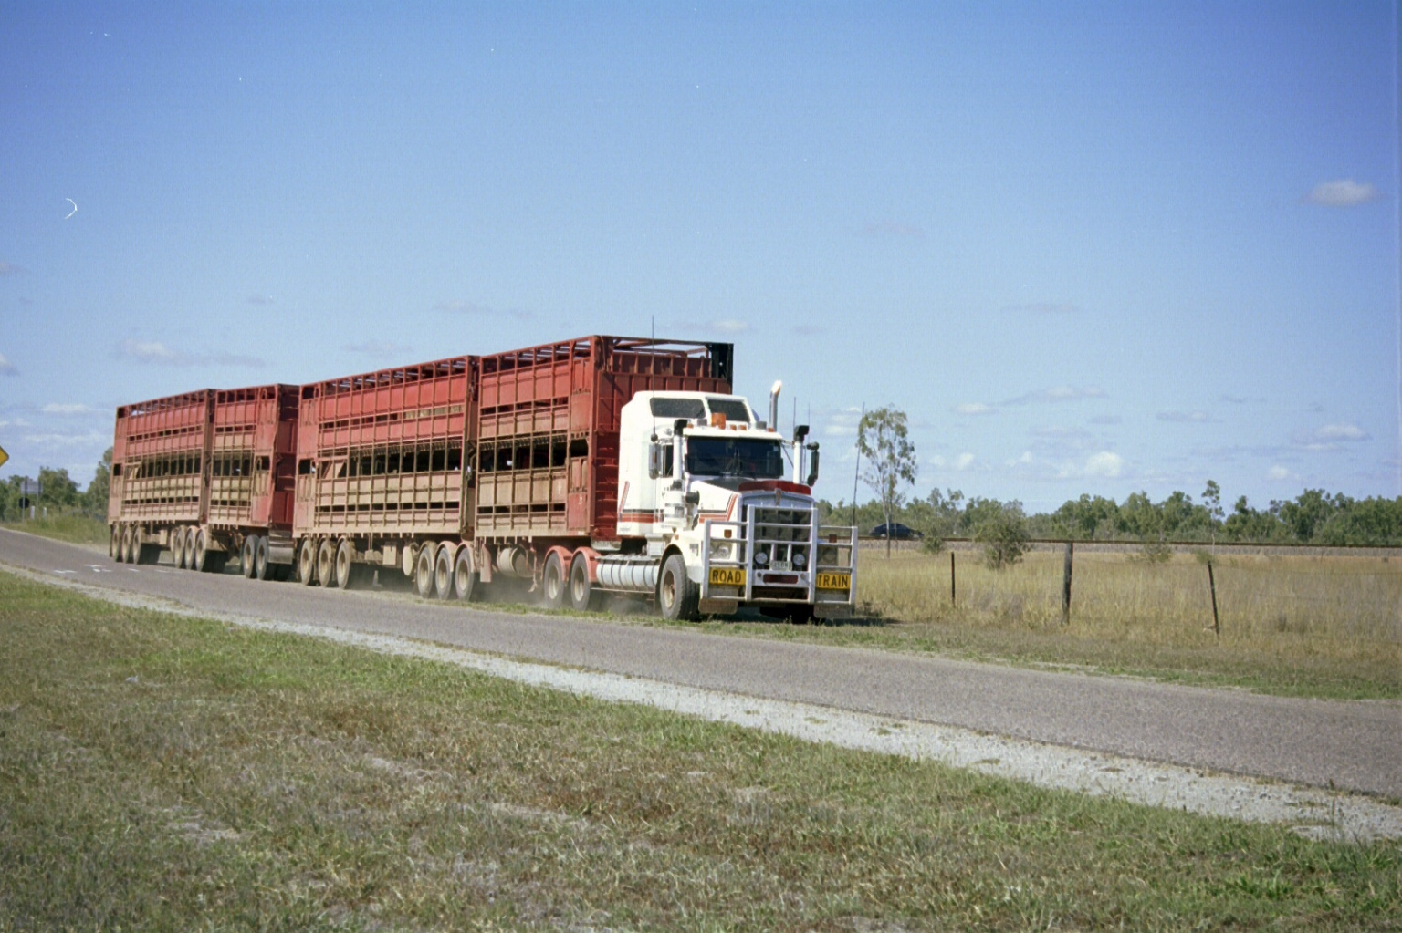
Significant improvements in vehicle performance
Conventional vehicle option: Type 2 Road Train
Innovative vehicle option: BAB-Quad
freightweek.com.au
Road Transport Trends > Safer, more productive transport

Slide 4
PBS operations
Based on Qld data the crash rates are significantly better (cca 50% improvements)
Better dynamic performance characteristics
Stricter requirements:
Operating conditions (loading, NHVAS etc.)
Driver training and reporting
Better equipment
Increased monitoring, improved compliance
freightweek.com.au
Road Transport Trends > Safer, more productive transport

Slide 5
Improved fleet performance
More innovative/PBS combinations
Enhanced vehicle standards
Technological developments
Safer operations
Better compliance
Environmental protection
freightweek.com.au
Road Transport Trends > Safer, more productive transport

Slide 6
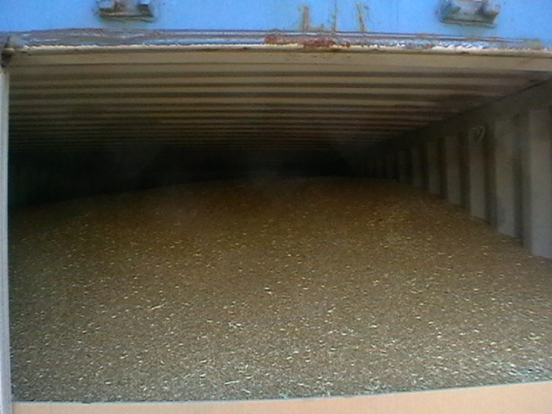
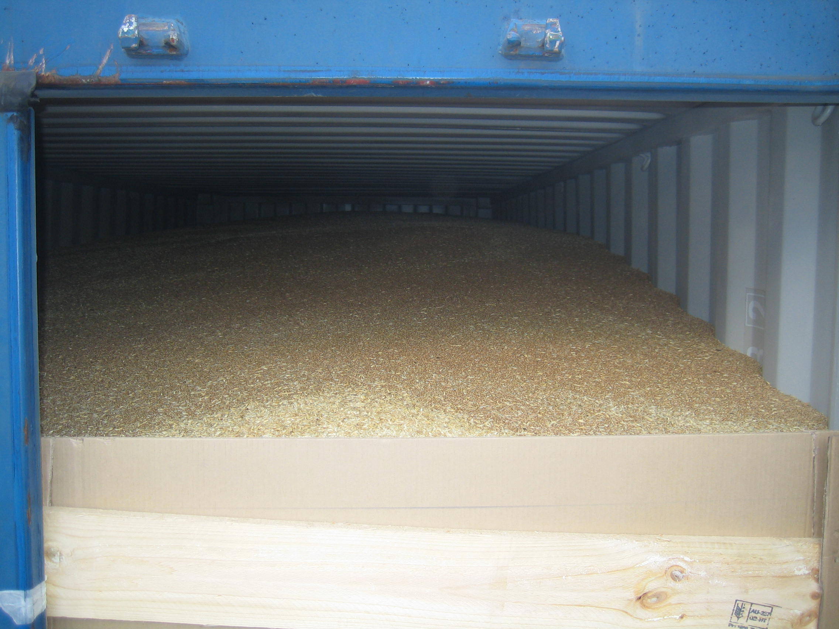
Performance is the key
Performance outcomes can be achieved in different ways
Innovative design (smart dolly or active steering)
Load height and design restrictions
Simulation: ARRB
freightweek.com.au
Road Transport Trends > Safer, more productive transport

Slide 7
PBS A-doubles
freightweek.com.au
Road Transport Trends > Safer, more productive transport

Slide 8
Possible trends
Use of technologies
Better vehicle design (steering systems, combinations, load control)
Monitoring
Electronic vehicle systems (RSC, ECS)
Review of PBS and allowing technologies to be used (next big thing to come!)
Special vehicles for special tasks
ITS
freightweek.com.au
Road Transport Trends > Safer, more productive transport

Slide 9
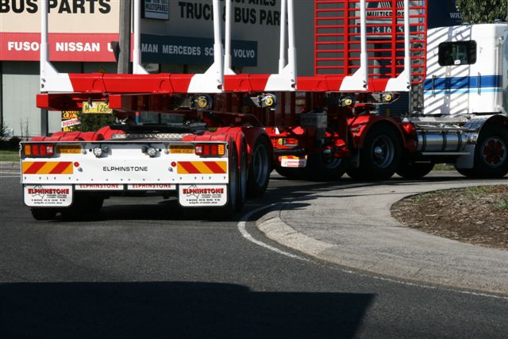
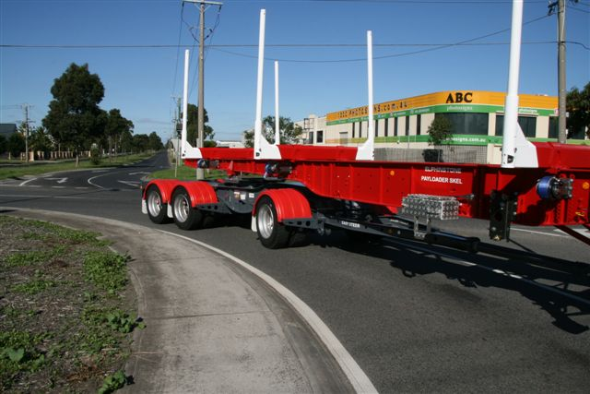
Better regulations
HV regulations could limit innovation
freightweek.com.au
Road Transport Trends > Safer, more productive transport

Slide 10
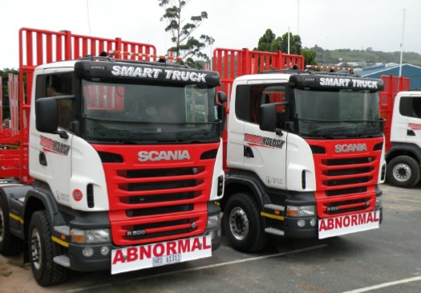
PBS in South Africa
freightweek.com.au
Road Transport Trends > Safer, more productive transport

