Slide 1

Freight Week
September 2013
Russell Greenland
TSS Manager Metro Operations
Regulatory Services

Slide 2


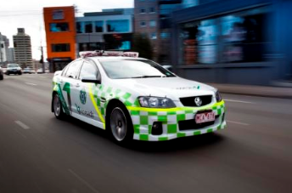
VicRoads - Transport Safety Services
(TSS)
The TSS Group:
Operational in each of the five VicRoads country regions and one metropolitan region
54 Authorised Officers
8 Overdimensional Permit staff
CoR/Tow Truck Investigations group

Slide 3
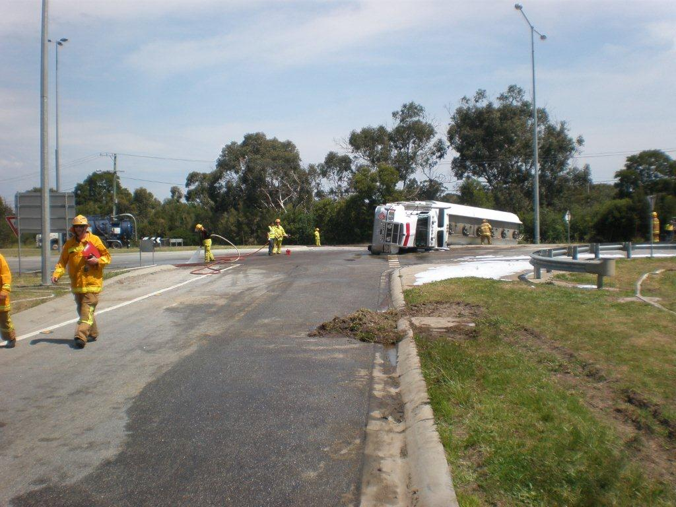
Tanker Roll over – October 2011
Notes:
3

Slide 4
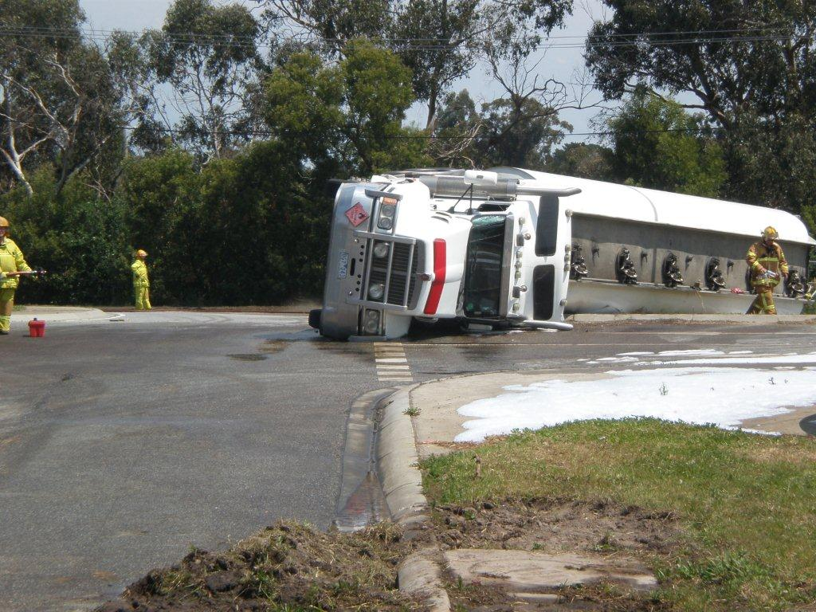
Tanker Roll over
Notes:
4

Slide 5
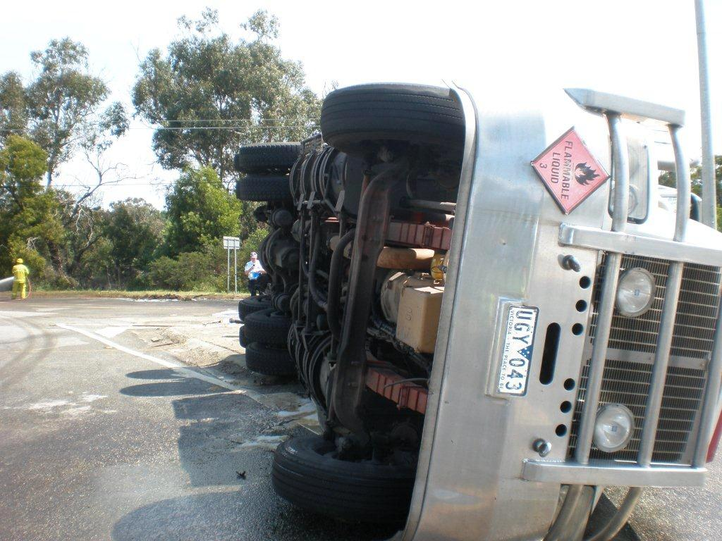
Tanker Roll over
Notes:
5

Slide 6
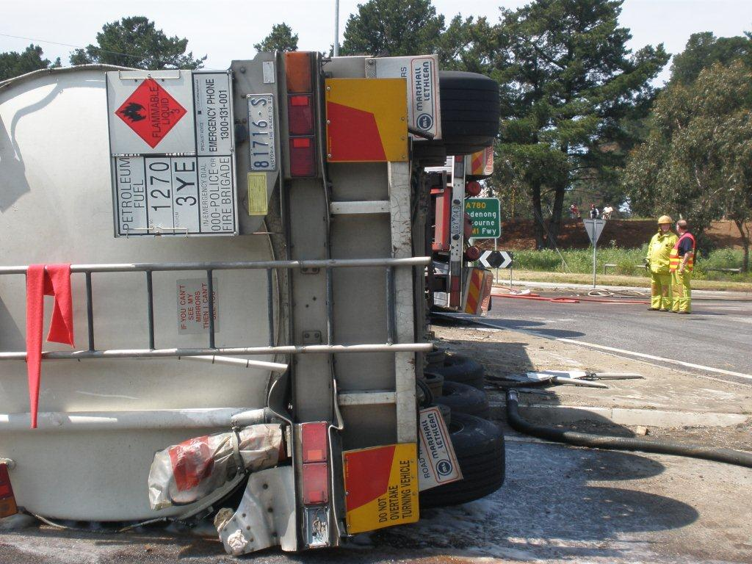
Tanker Roll over
Notes:
6

Slide 7
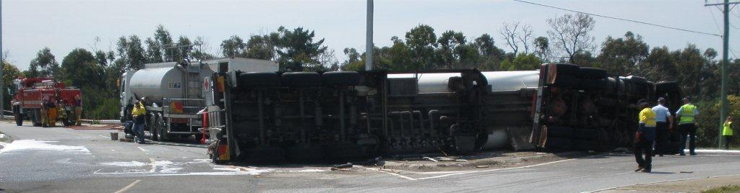
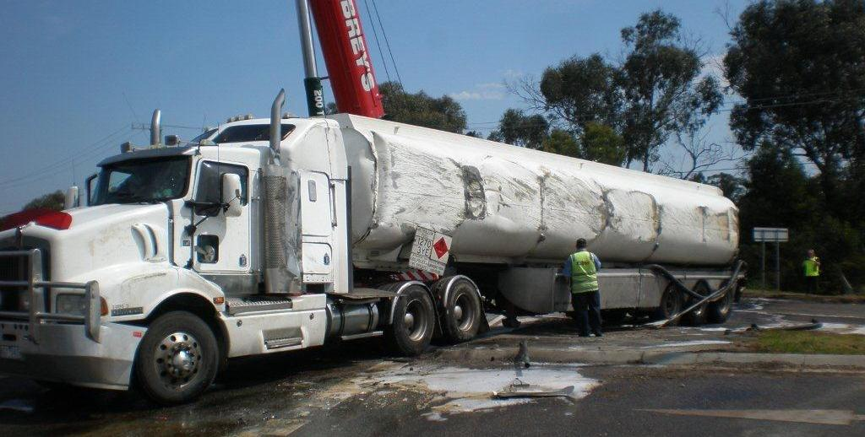
Tanker Roll over
Notes:
7

Slide 8
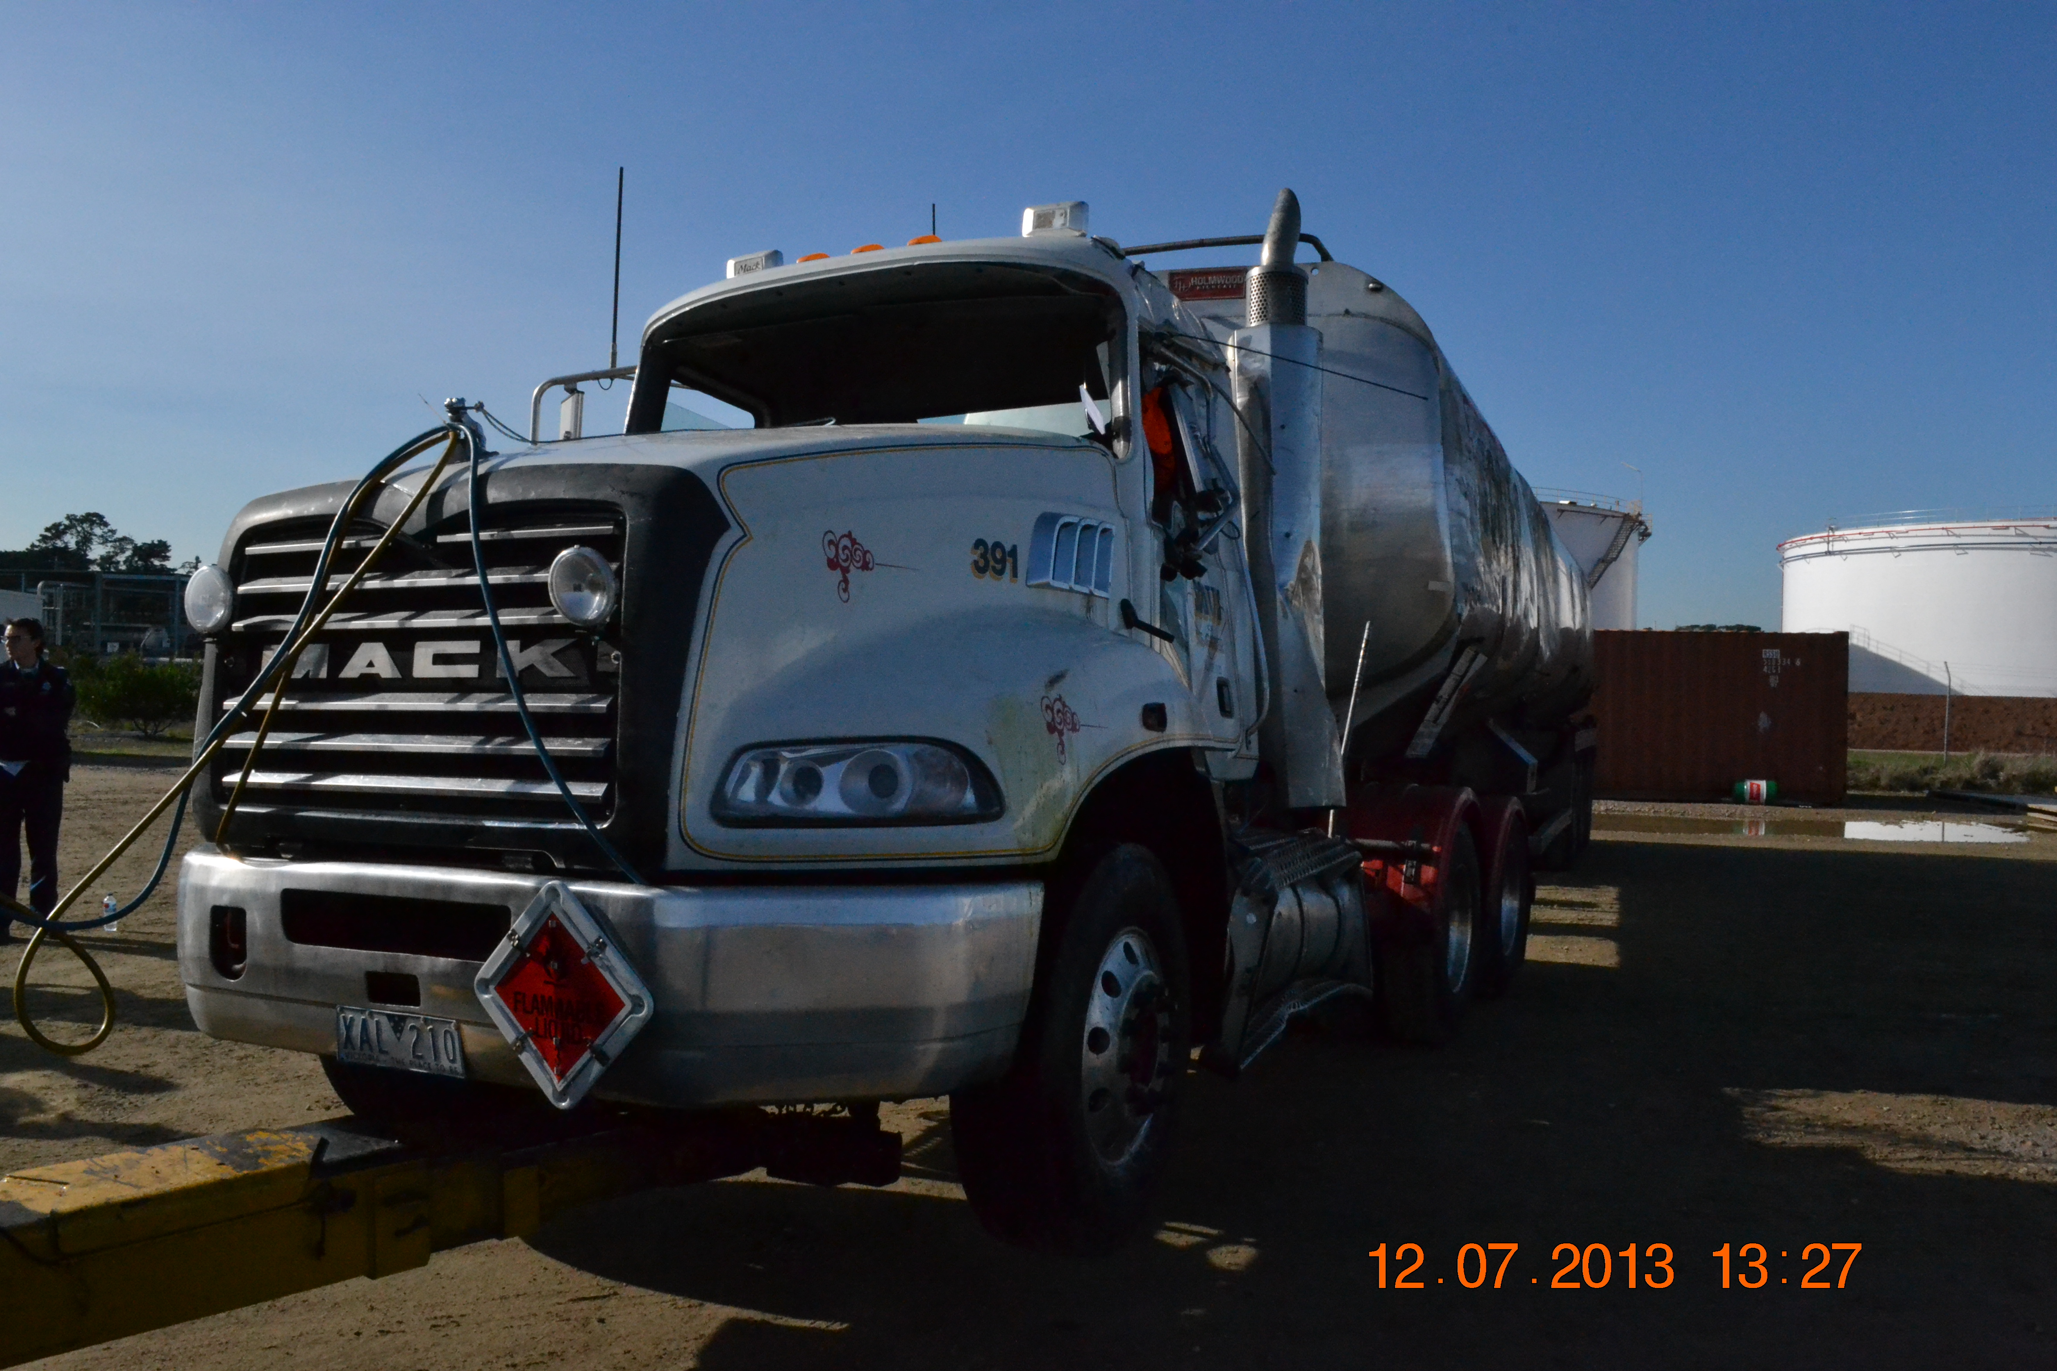
Tanker Roll over – July 2013
Notes:
8

Slide 9
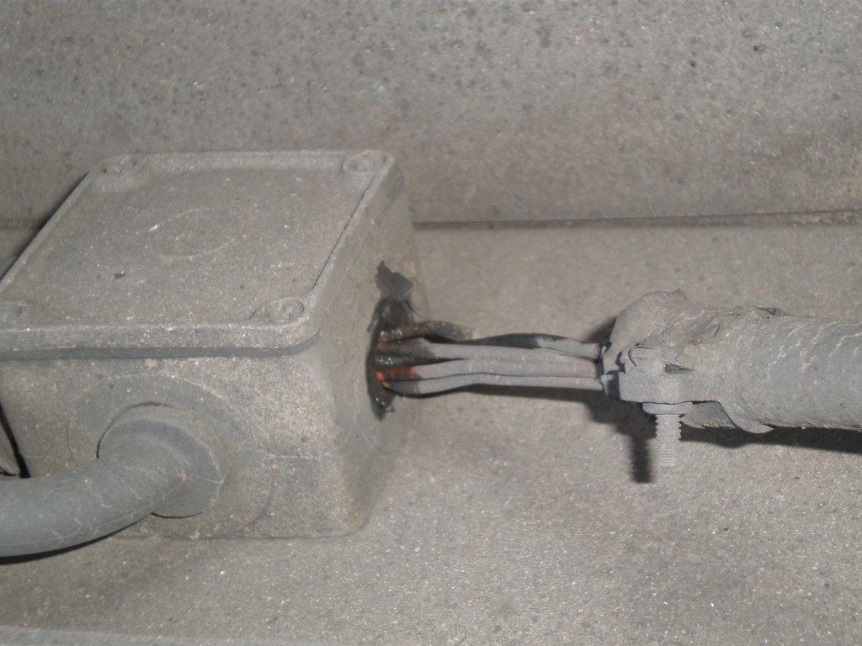
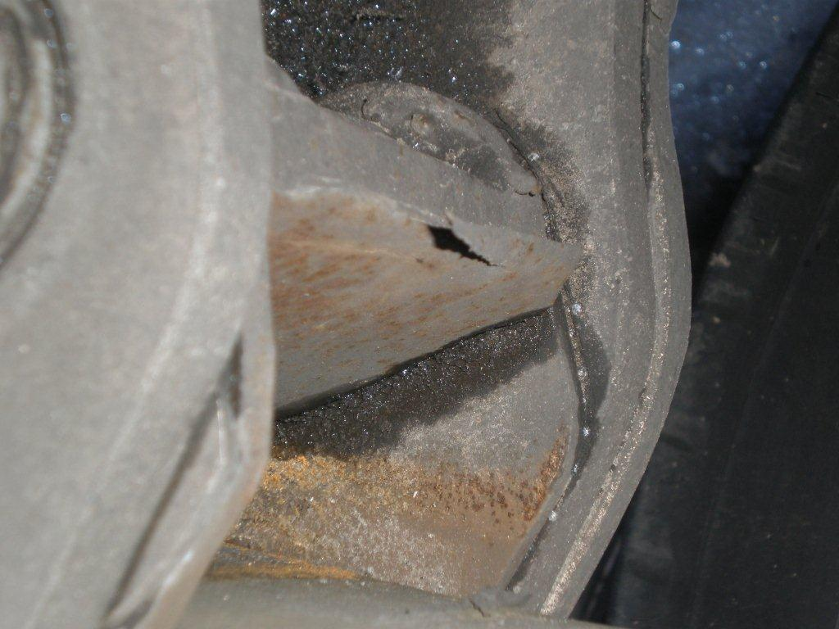
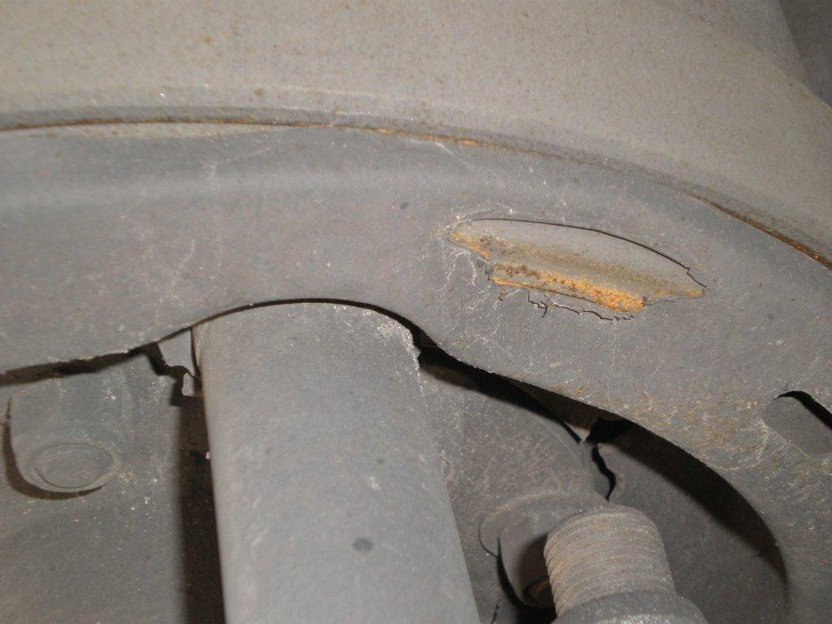
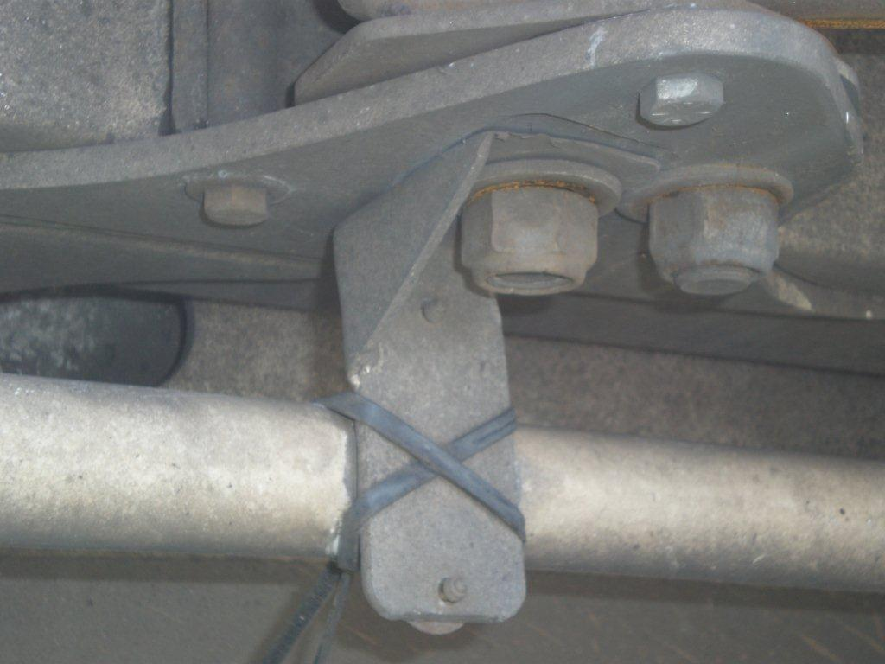
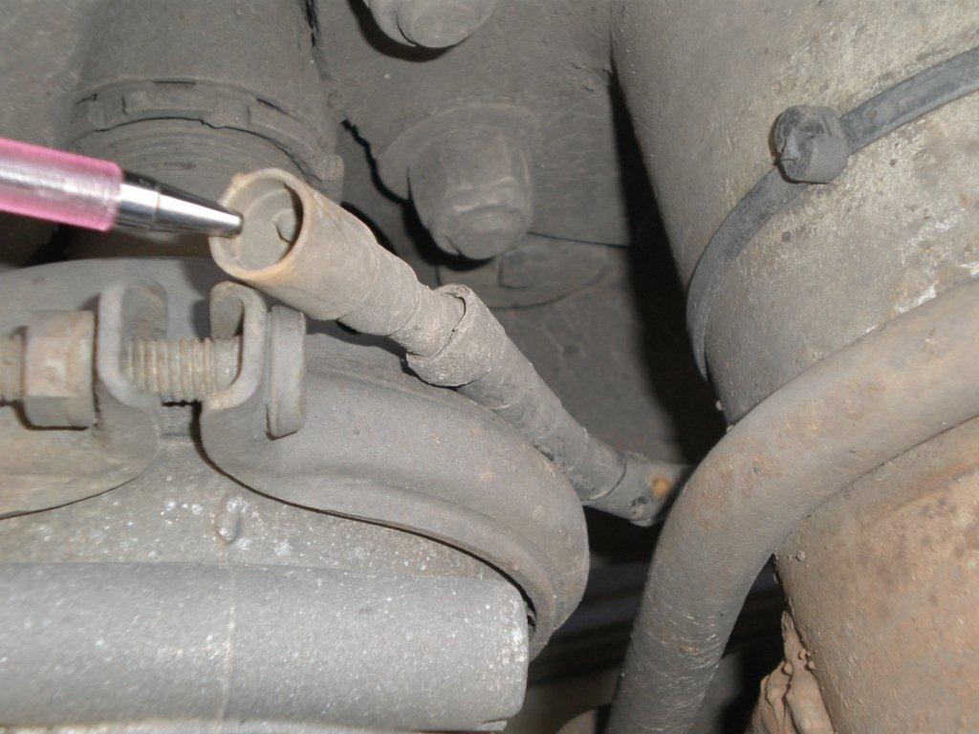
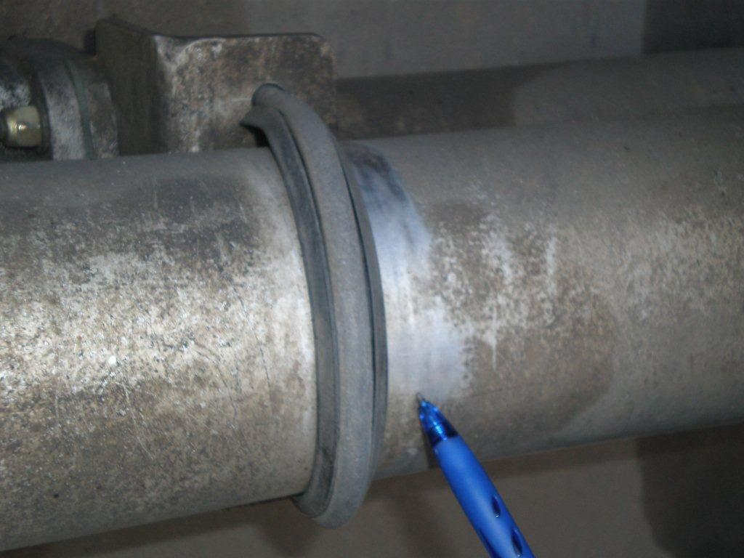
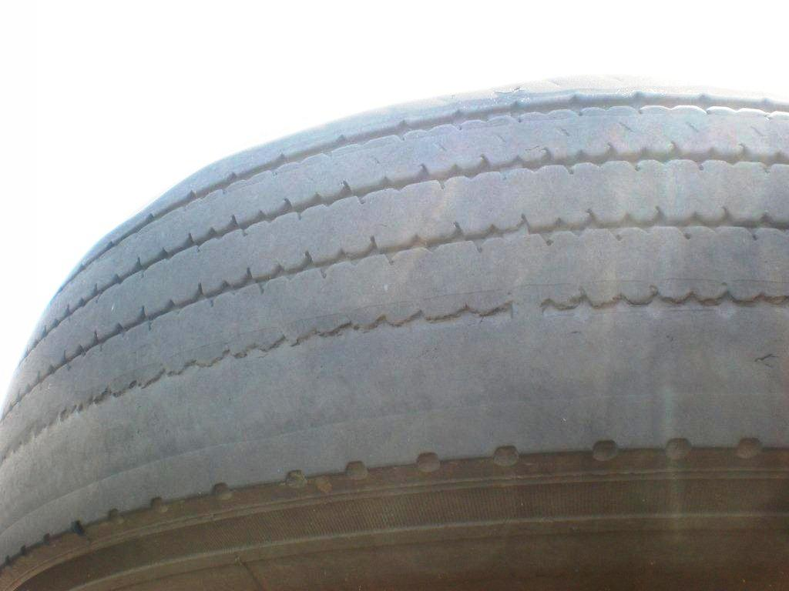
Our Role is still this:
Notes:
9

Slide 10
Training for after the event
Transport Industry Skills Centre
National Bulk Tanker Association
CROIERG
(Canberra and Regions Oil Industry Emergency response Group)
Course in Dangerous Goods Road Transport Emergency Recovery Operations
(3-5 October 2012)
Notes:
10

Slide 11
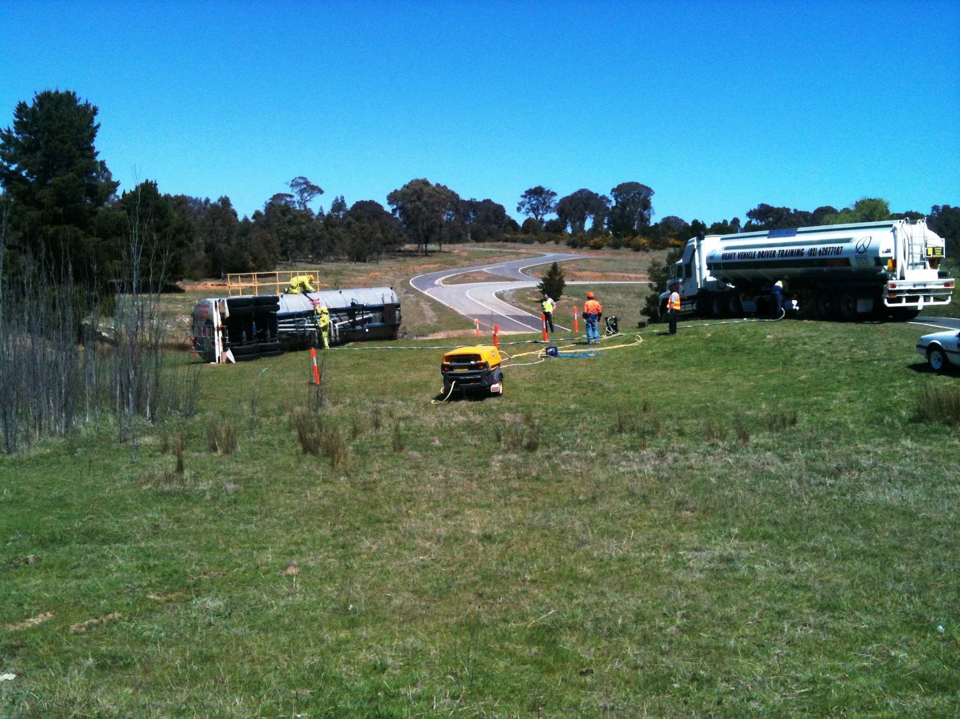
Course in Dangerous Goods Road Transport Emergency Recovery Operations
Practical component and assessment
Notes:
11

Slide 12
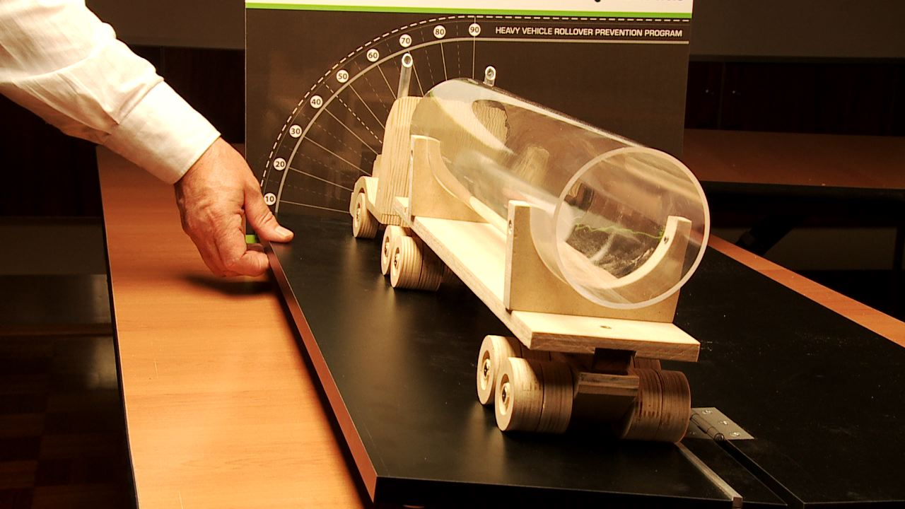
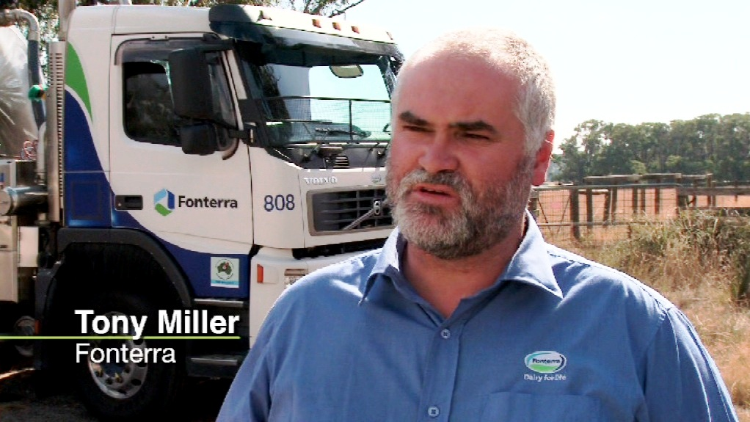
VicRoads - Heavy Vehicle Rollover Protection Program
Partnerships
- developing tools to assist industry
Heavy Vehicle Rollover Protection Program
Notes:
12

Slide 13
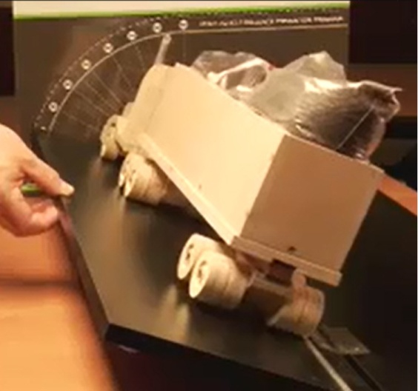
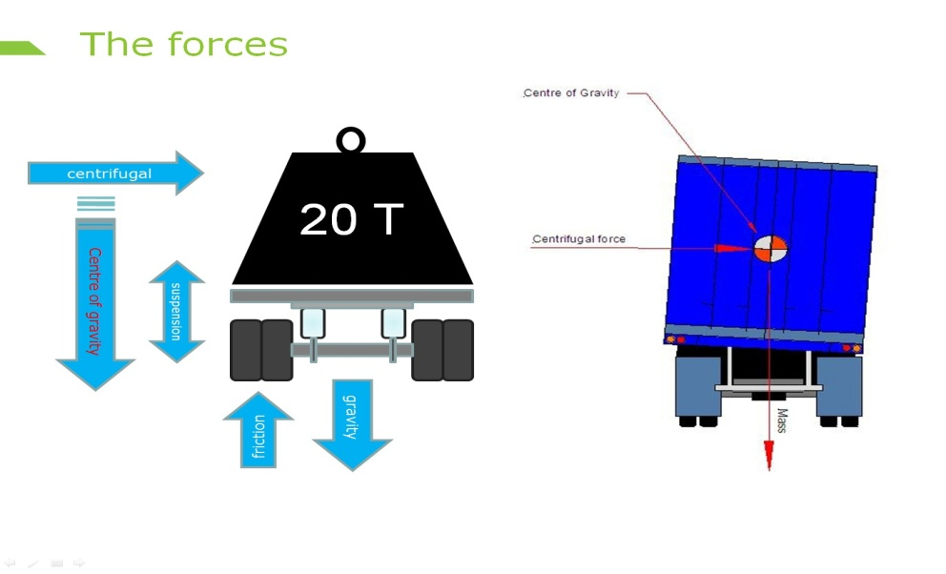
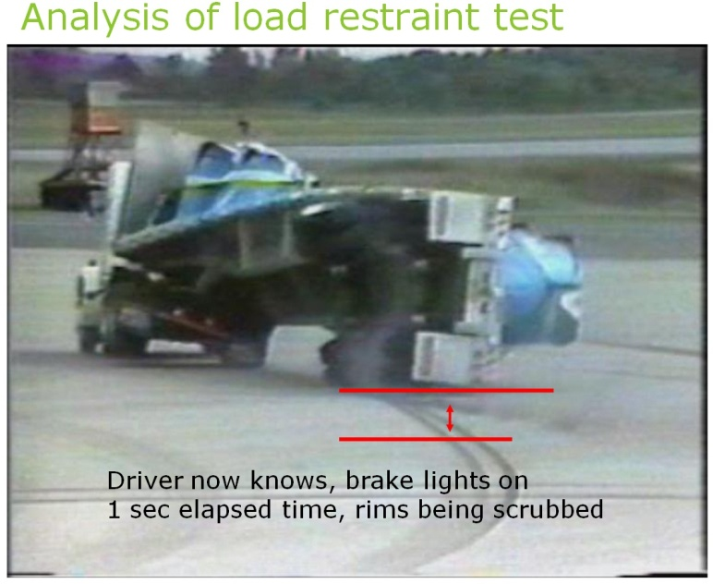
VicRoads Heavy Vehicle Rollover Prevention Program
Received the Australian Freight Industry Award for Best Safety Program 2011.
Over 200,000 DVD packs by demand to over 50 countries, subtitled in 4 languages by others.
Proven results in significant crash reduction overall, not just rollovers
Companies implementing the program principles have realised increases in productivity including
    fuel savings
    reduction of wear and tear, and maintenance costs.
    reduction of OH&S issues and costs
More information via website: vicroads.vic.gov.au/truckrollover
or email: truckrolloverprogram@roads.vic.gov.au
Notes:
The program was developed by VicRoads in conjunction with the Road Freight Advisory Council to help address the concerns about the rollover crash issues.
The programs key focus is that all links in the logistics chain are responsible to facilitate behavior change which leads to the reduction of rollover crash risks. The program provides methods, examples and support to engage everyone, including the community, which all adds to the reduction of incidents.
It looks for and assists links in the chain taking ownership rather than blame, to implement simple and cost effective changes, which then induce behavioral changes clearly visible to all in the chain.
[For example, having schedulers ride in the truck to see first hand the issues faced by the driver, changes the limits the scheduler puts on the driver]
[Operations manager recommending and assisting a client implement forward planning ideas to prevent future ‘urgent’ delivery of material because the client ran out]
13

Slide 14
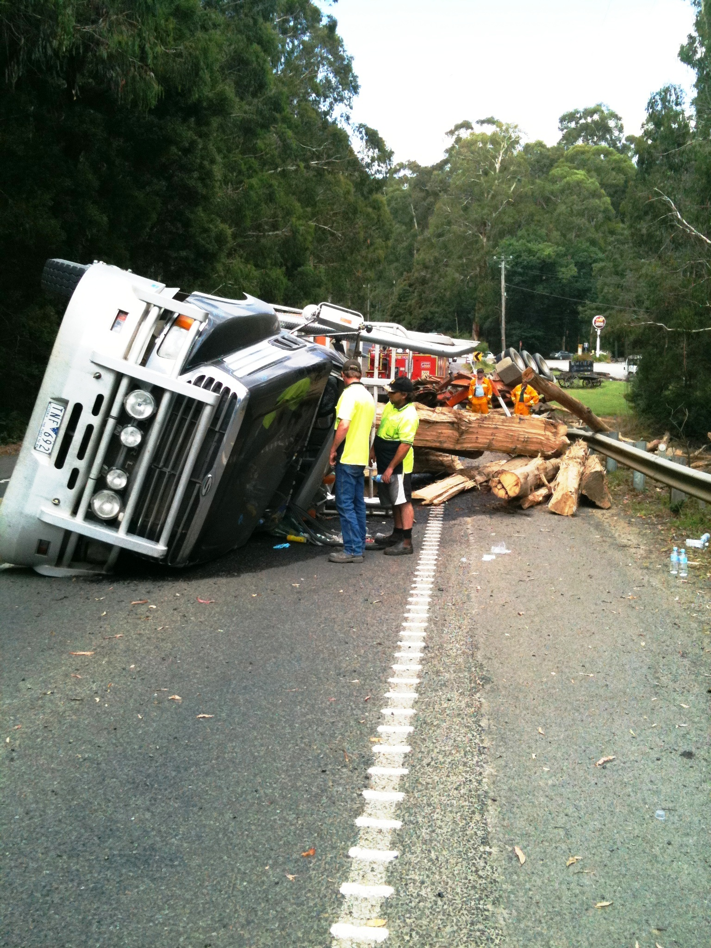
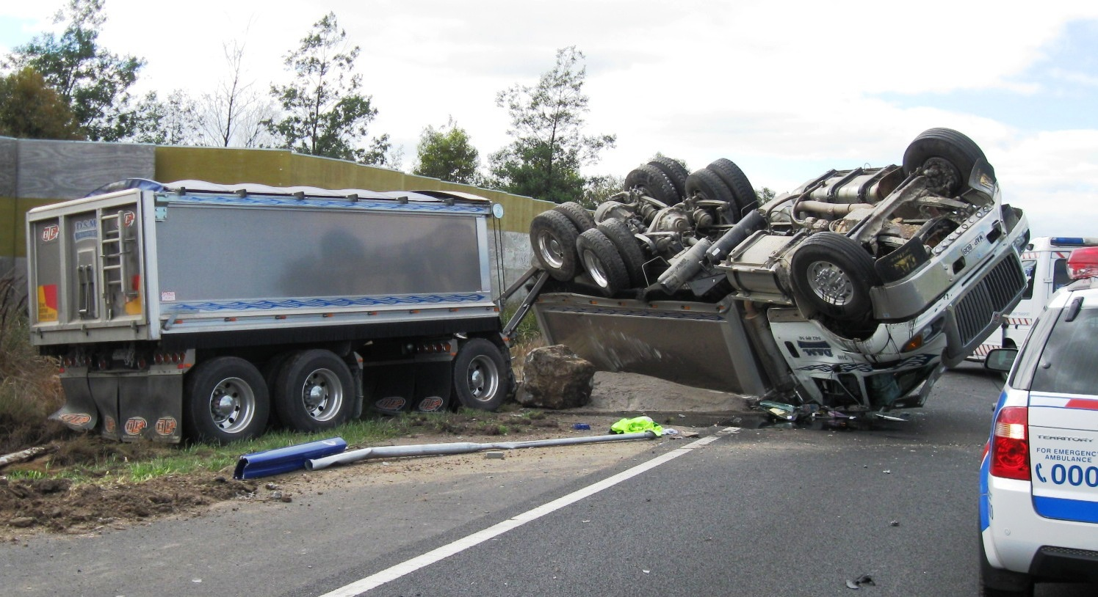
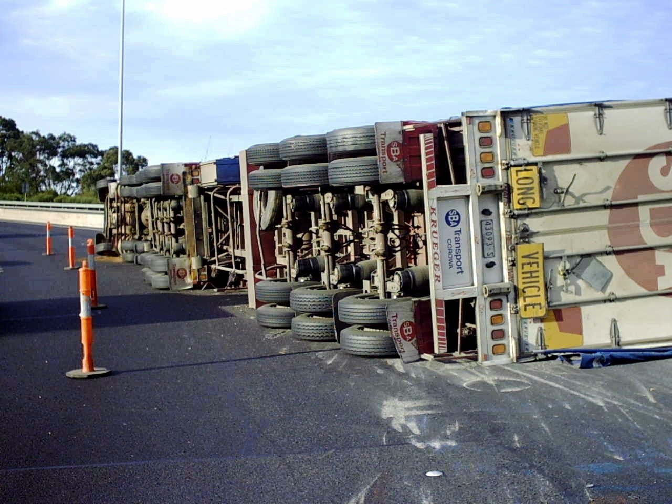
Heavy Vehicle Rollover Protection Program
Notes:
14

Slide 15
Heavy Vehicle Rollover Protection Program
Black Spur roll-over prevention project
23m B/Double access arrangements
Roll-overs were an ongoing issue
Log trucks/Jinkers have a high Centre of Gravity (CoG) and are more susceptible to a roll over
Code of Behaviour a requirement
Electronic Braking System (EBS) on all trailers a requirement of access (within 12 months 2009/10)
80% of the value in trailers
Notes:
15

Slide 16
Heavy Vehicle Rollover Protection Program
Black Spur roll-over prevention project
Prime movers required within 5 years.
Logging operators accepted trailer initiative but were against Prime Movers based on cost, lack of ability to retro fit EBS especially on US vehicles and overall benefit to roll over prevention.
VicRoads accepted that the prime mover inclusion would be problematic especially in line with the NHVR looking at future safety related issues.
Resulting in NO B/Double roll over's on the Black Spur since the introduction of EBS on trailers.
Calls from logging contractors expressing the benefit of reduced costs resulting from roll over damage and reduced loss of productivity. Supported by leading trailer manufacturer and repairer.
Notes:
16

Slide 17

Operation HAZARD
Three operations run by VicRoads to verify the state of the transport industry
Results from ‘Operation Hazard’ showed that 85 per cent of the vehicles checked were found to have defects with 77 per cent having major defects.
A major defect is one that presents an ‘imminent and serious safety risk’.
Notes:
17

Slide 18
Operation HAZARD
Metro Operations:
A third operation was planned to replicate the first operation by using the same locations, staff numbers and time of year as a benchmark
Locations included:
Braeside: 65%
Clayton: 79%
Lilydale: 80%
Lyndehurst: 84%
Dandenong: 87%
Overall: 79% (150Major, 102 Minor, 252 vehicles out of 320 vehicles checked)
Notes:
18

Slide 19

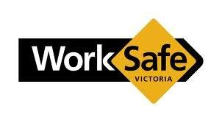
Operation TRISHULA
Roadworthy Project – October 2012 – May 2013
Three roadworthy partners
Metropolitan and Country Victoria
Address concerns of Operation Hazard
Results from ‘Operation Hazard’ showed that 85 per cent of the vehicles checked were found to have defects with 77 per cent having major defects.
A major defect is one that presents an ‘imminent and serious safety risk’.
Notes:
19

Slide 20
Operation TRISHULA
Eastern Region | Yarragon, Morwell, Traralgon, Rosedale, Yarragon
Metro South East | Braeside, Clayton, Lilydale, Lyndhurst, Dandenong
North Eastern Region | Katamatite, Wodonga, Yarrawonga, Shepparton, Mangalore
Northern Region | Gisborne, Bendigo, Charlton, Swan Hill, Echuca
Metro North West | Sunshine, Campbellfield, Somerton, Brooklyn, Yarraville
South Western Region | Geelong, Waurn Ponds, Portland, Warrnambool
Western Region | Ballarat, Avoca, Warracknabeal, Horsham, Ballarat
Notes:
20

Slide 21
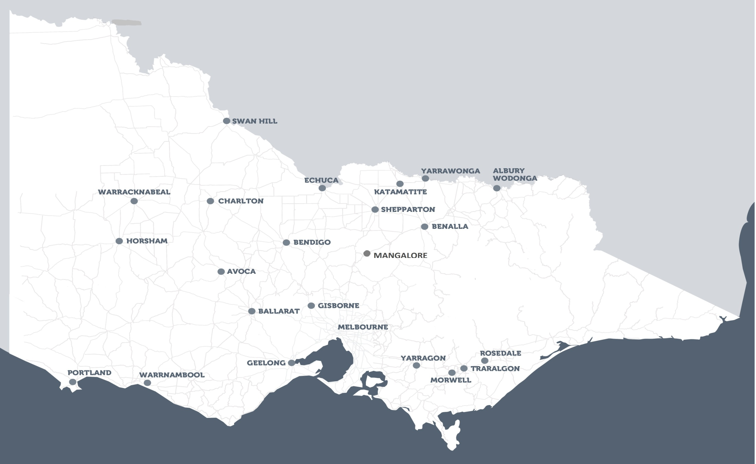
Operation TRISHULA
Notes:
21

Slide 22
Operation TRISHULA
VicRoads Region | Eastern | Metro South East | North Eastern | Northern | Metro North West | South West | Western | Total
Interceptions | 185 | 320 | 194 | 236 | 306 | 234 | 218 | 1693
Defect Notices (TOTAL) | 118 | 252 | 111 | 189 | 271 | 177 | 182 | 1300
Defect Notices (Major) | 79 | 150 | 66 | 89 | 154 | 53 | 97 | 688
Defect Notices (Minor) | 39 | 102 | 45 | 100 | 117 | 124 | 85 | 612
Intercept/Defect Ratio | 63.8% | 78.8% | 54.6% | 74.8% | 88.5% | 69.8% | 73.8% | 72.0%
Notes:
22

Slide 23
Operation TRISHULA
Defect Types - By Percentage of all vehicles intercepted | Total
Brakes | 25.7%
Tyres | 23.7%
Chassis / Body (inc Rust) | 20.9%
Suspension | 11.7%
Seatbelt | 11.0%
Steering | 9.9%
Vehicles Grounded / Towed | 71
Notes:
23

Slide 24
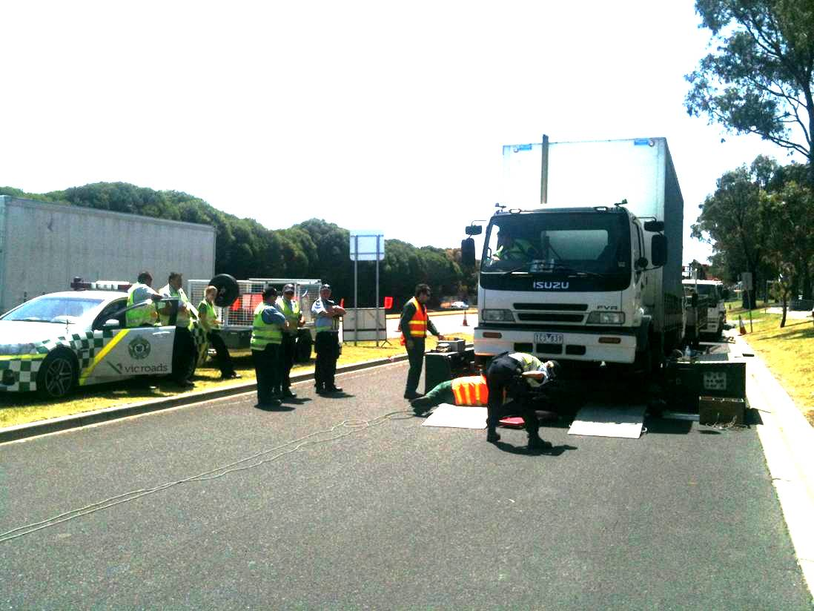
Operation TRISHULA
Notes:
24

Slide 25
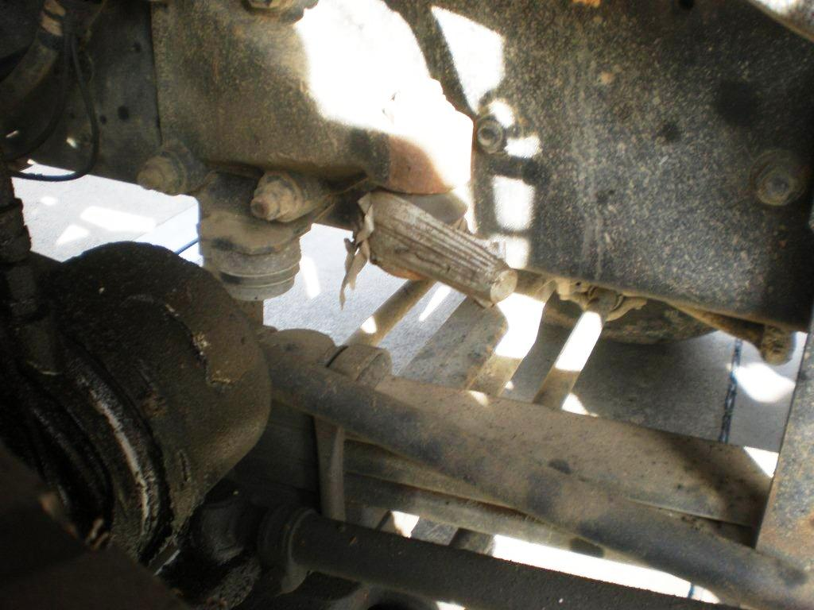
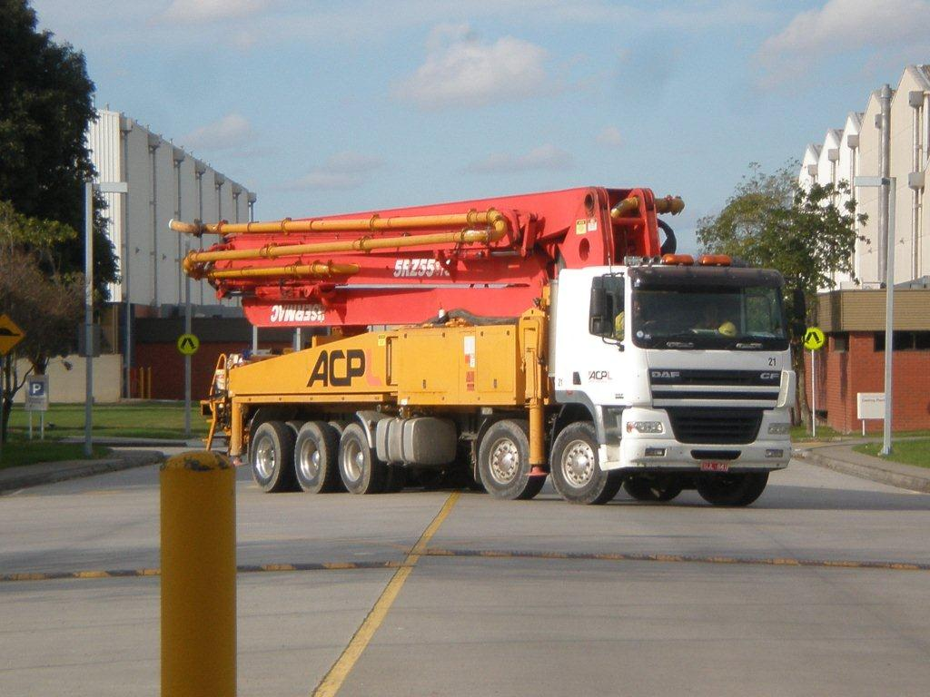
Operation TRISHULA
Notes:
25

Slide 26
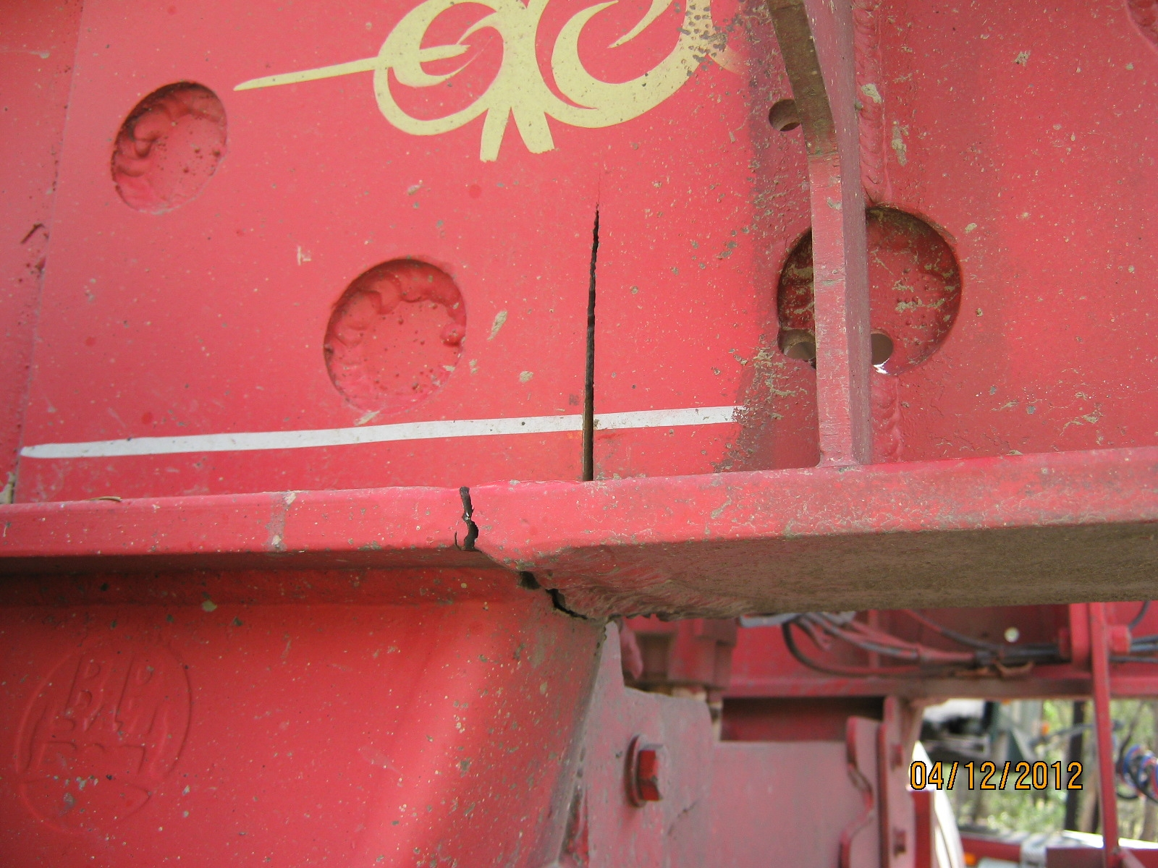
Operation TRISHULA
Notes:
26

Slide 27
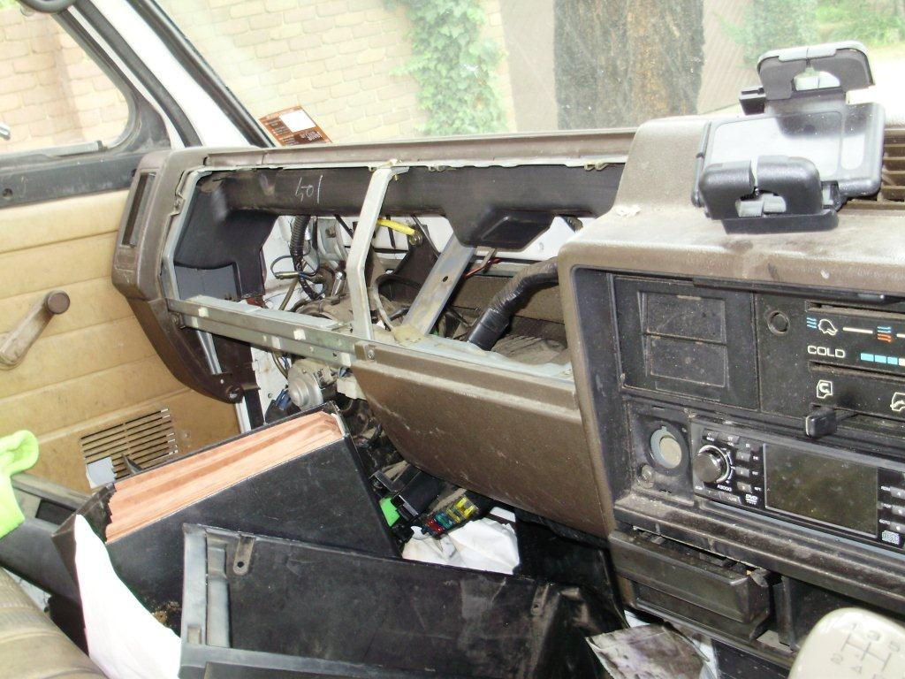
Operation TRISHULA
Notes:
27

Slide 28
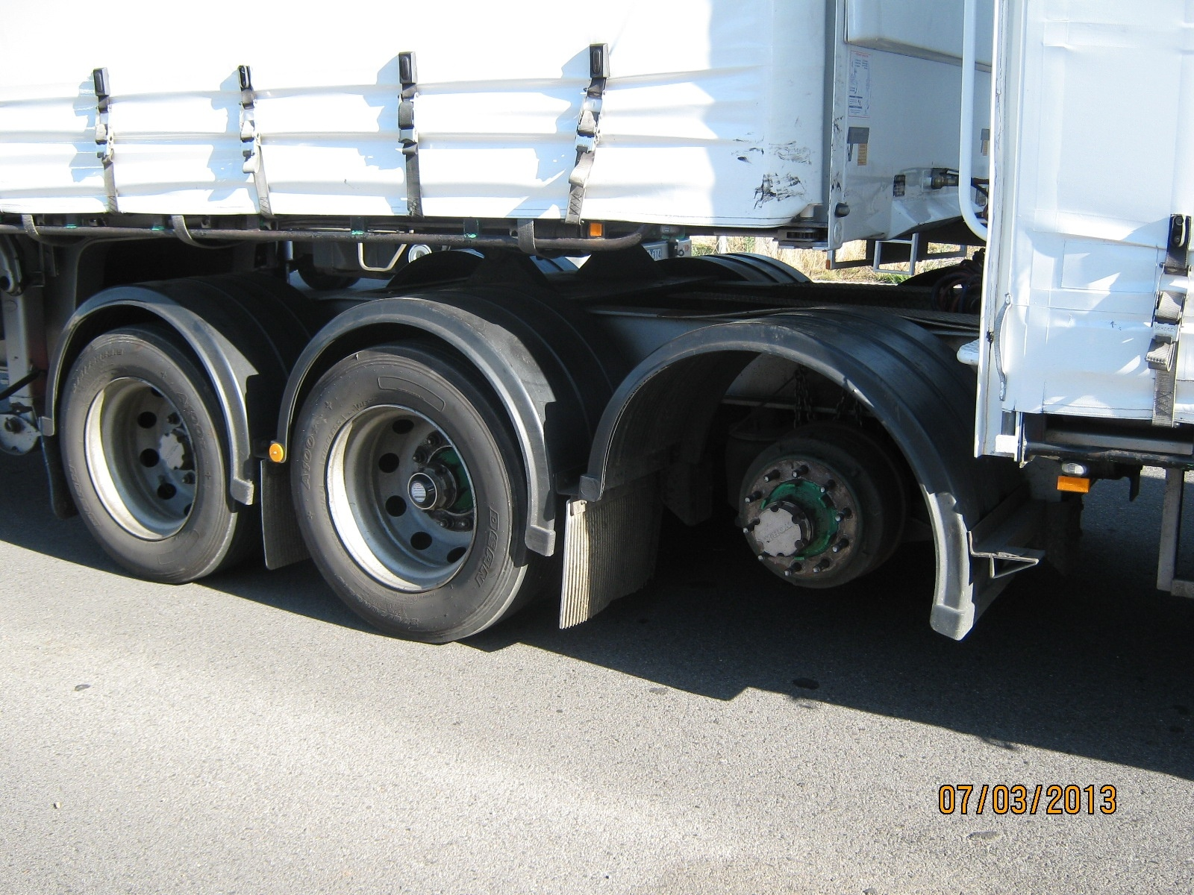
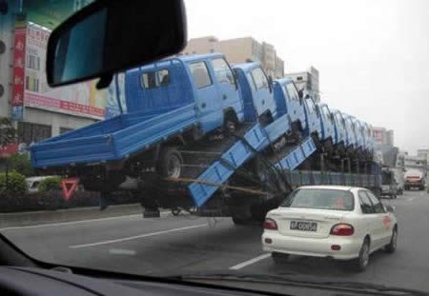
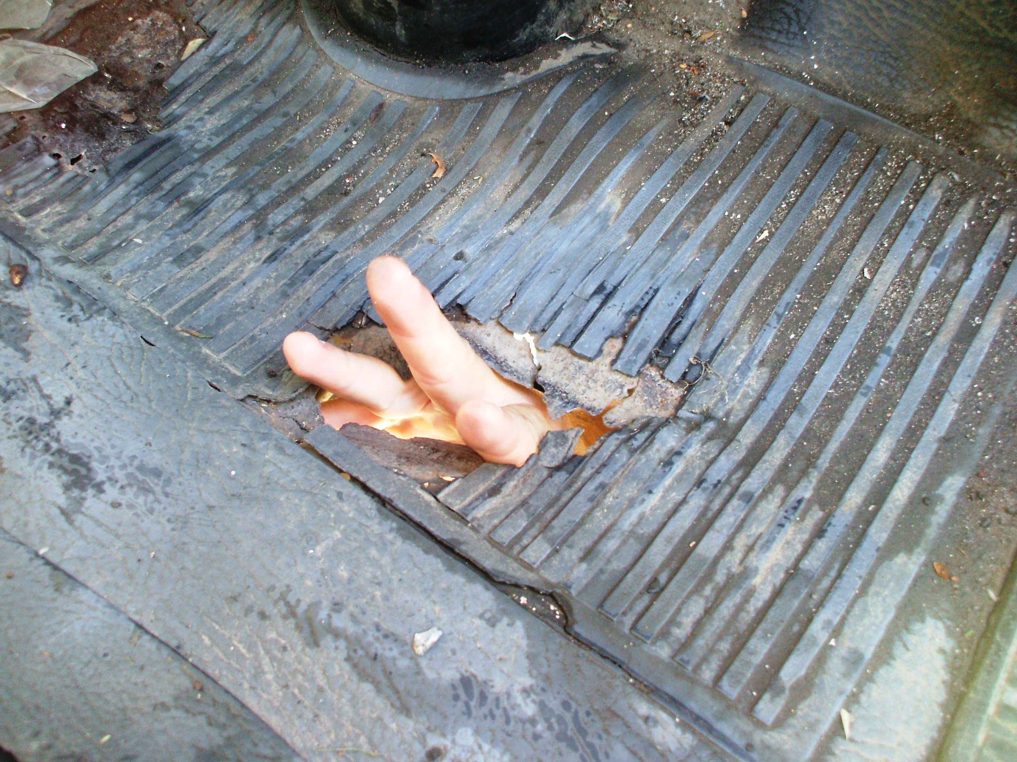
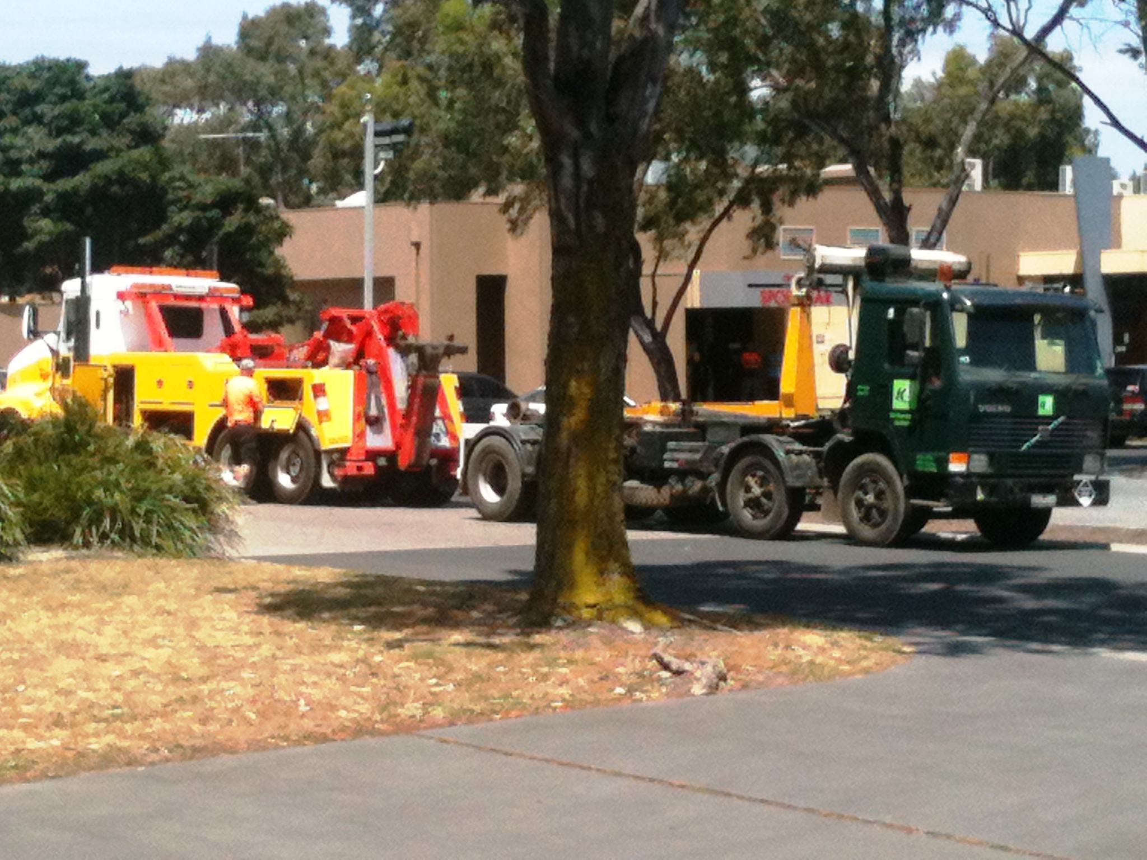
Operation TRISHULA
Notes:
28

Slide 29




Questions?

