Slide 1

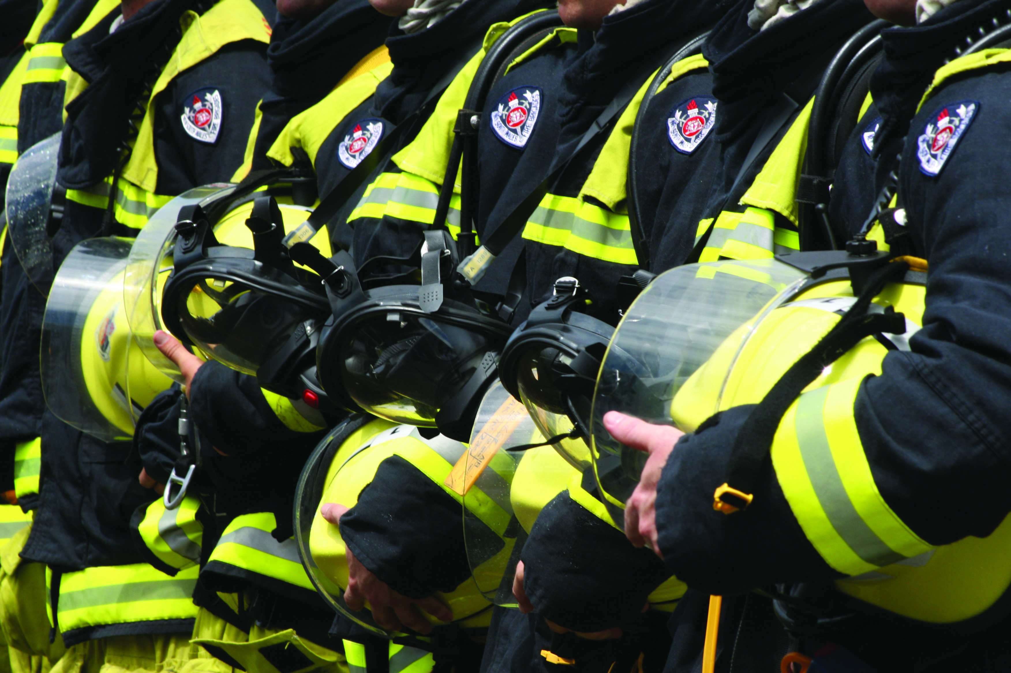

Freight Week 2013
Rob McNeil, Director Regional Operations

Slide 2

Objectives
Prevention
Good preparedness leads to prevention thinking & better recovery
The challenge is to drive the need & make it a priority
Notes:
FRNSW will required strong leadership at all levels throughout our directorate to drive our goals over the next year.
This session looks at what our goals are, how to approach the change environment, the challenges we face as leaders and some ideas on how we can face those challenges as individual leaders of our teams and as a team leading the change.

Slide 3
Prevention is better than cure.

Slide 4
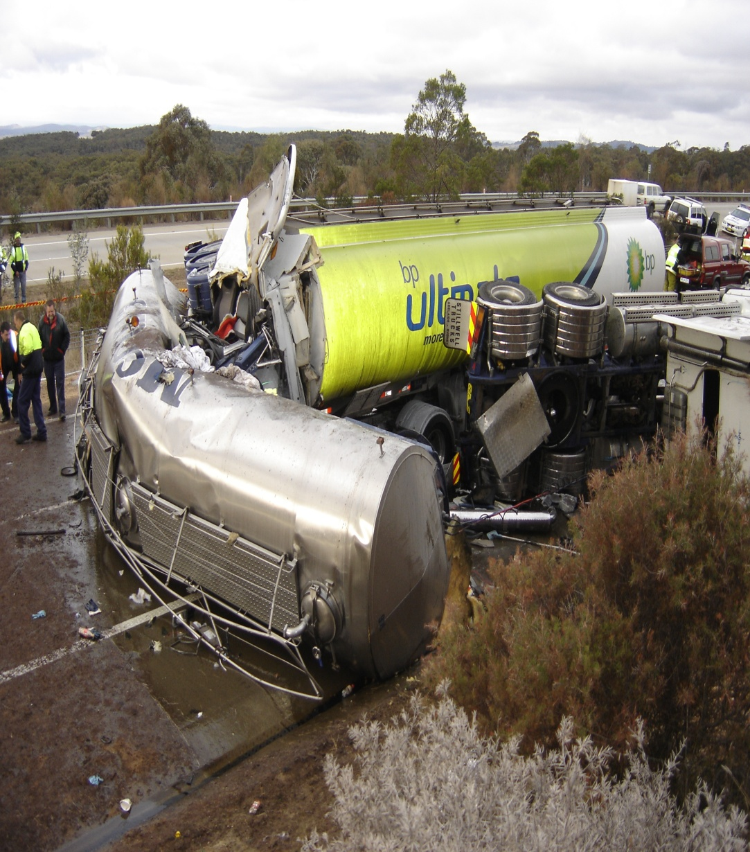
Prevention
  Human cost
  Community cost
  Environmental cost
  Business cost
Notes:
From the Commissioner down we need to be leading in the same direction, admired emergency service, community based, leading practices, adaptable people and adaptable systems.
At each level we need to set the goals relevant to our team that to achieve the main goal.
What is a critical component of achieving the same goal amongst our leadership team? We are all committed to it, we are all on the same bus. This will lead to having uncomfortable conversations with personnel who aren’t on that bus.
Efficiencies require change and the leaders have to effectively communicate the need for the changes and how they will help achieve the goal.
The challenges will be to promote and implement the change and it can be achieved by developing a coordinated action plan and implementing it.

Slide 5
Prevention
How does prevention become a priority?
a) Personal impact, injured lost loved one
b) Cost, lose of business
c) Prosecuted
d) Loss of faith in the industry by the community

Slide 6
Challenges for Our Leaders
Drive Prevention
  Accept initial cost for long term benefits
  Lead the change with the vision.
Notes:
Flexible workforce requires numerous changes to work practices which are creating inefficiencies, especially due to the tyranny of distance and isolation of resources.
What are some examples of a more flexible work force?
What are some of the difficult conversations that would be needed in this area.

Slide 7
Change is Happening.
Change is happening
  Standardised Emergency Responders Course
  Joint training exercises and training tools.
  NBTA, CROIERG, TISC and AFAC.
  FRNSW Commanders are doing the course
    This will ensure an understanding and a create demands for qualifications at the scene.
Notes:
NBTA 7 march Sandown
CROIERG training tools.
Industry supporting training tankers.

Slide 8
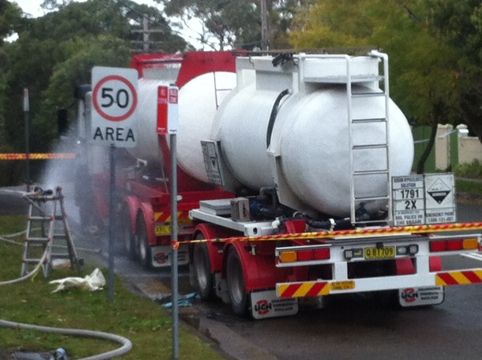
Case Study
22 August 2013 @ 0647hrs
Pacific Hwy Pymble
Sodium Hypochlorite, 5000ltr reported as Chlorine
Potential Major Peak Hour
Disruption
Driver took proactive measures driving vehicle off Pacific Hwy
Incident resolved 1538
Recovery team had qualifications
Consistent Safety Standards.

Slide 9
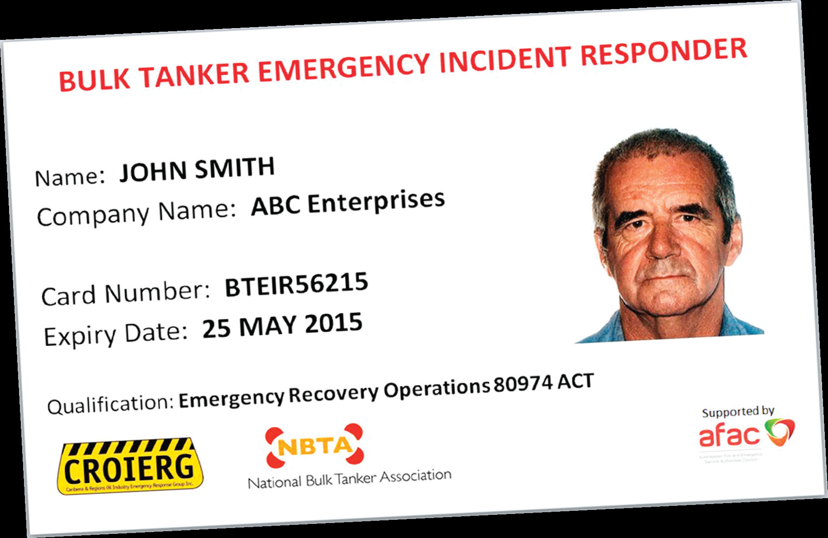
Case Study
23 July 2013 New England Hwy B double. 50k Ltr various petrol grades.
Tanker rollover happened in exact location in 2008
Recovery team good on IM and IAP
Consistent PPE / PPC
Agencies attended;
FRNSW, Police, Ambulance, RMS, EPA, Maitland Council, Towing company Recovery team & Owner of transport company.
Notes:
PPC issue

Slide 10
Case Study
Interview with Tim Seymour, Inspector, Maitland Police, about a truck roll that's closed ...
ABC Newcastle, Newcastle, Breakfast, Aaron Kearney 23 Jul 2013 6:21 AM
Duration: 3 mins 18 secs - ASR AUD 1,580 - NSW - Australia - ID: W00053956499
Interview with Tim Seymour, Inspector, Maitland Police, about a truck roll that's closed the New England Highway near Maitland
Hospital. Seymour says they have Hazmat crews and fire crews on site. He says no one has been injured and it's only one truck that
has rolled.
10,000 ALL
5,000 MALE 16+
5,000 FEMALE 16+
Interviewees
Tim Seymour, Inspector, Maitland Police
Also broadcast from the following 1 station
ABC Upper Hunter (Muswellbrook)
Notes:
10

Slide 11
Case Study
The New England Highway is now open a Maitland after a serious accident this morning ...
ABC Newcastle, Newcastle, 15:00 News, Newsreader 23 Jul 2013 3:03 PM
Duration: 0 min 41 secs - ASR AUD 146 - NSW - Australia - ID: W00053965245
The New England Highway is now open a Maitland after a serious accident this morning where a tanker carrying nearly 50,000L of
fuel and heating oil rolled.
6,000 ALL
2,000 MALE 16+
3,000 FEMALE 16+
Notes:
11

Slide 12
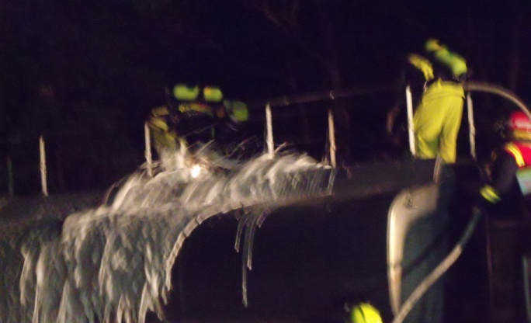
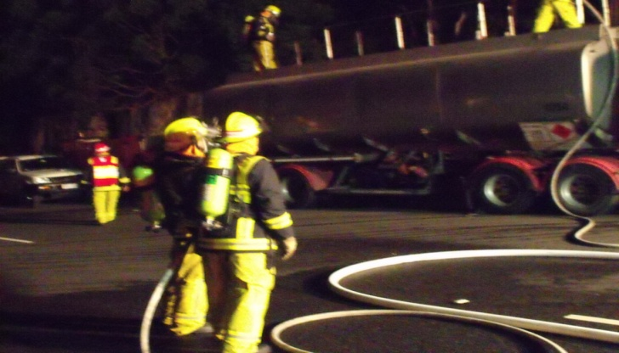
Discussion
During 2012 / 13 FRNSW responded to 44 tanker rollover incidents.
Notes:
12

