Slide 1
NBTA Bulk Tanker Day 2016
The Year in Review:
NSW EPA perspective

Slide 2
DG TANKER FOCUS AREAS 2015-16
Hazmat incident investigation and follow up
Joint roadside compliance campaigns
Work with other NSW regulators, with Vic and national advocacy via CAP and NTC
Older DG tanker vehicle safety project
Review of prohibited routes
Determinations on stability control (update)
Notes:
Major focus areas the EPA has been working on during 2015-16

Slide 3
HAZMAT Incident Investigation/Follow Up
All HAZMAT incidents involving road transport of dangerous goods are investigated
Matters that led to the incident reviewed
Regulatory action is taken for breaches
Lessons for improving incident response procedures

Slide 4
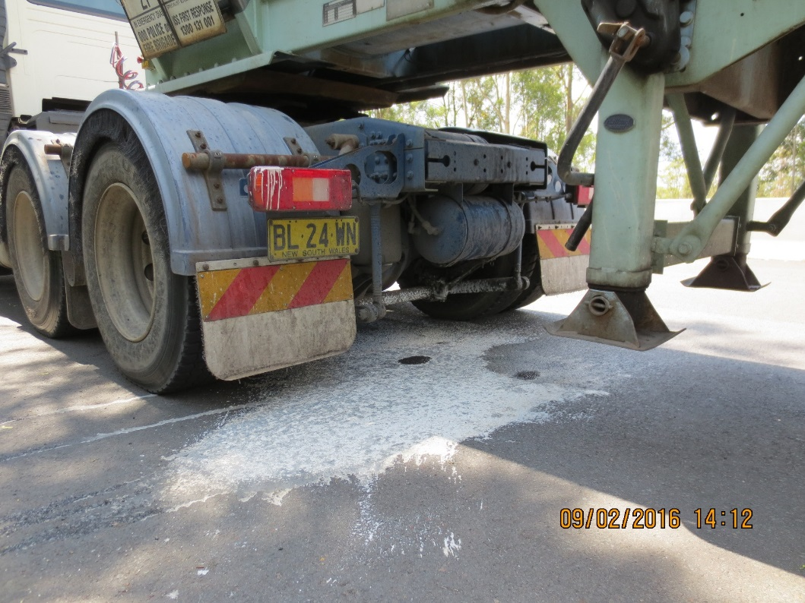
Notes:
98% Sulfuric tanker leaking in three separate places

Slide 5
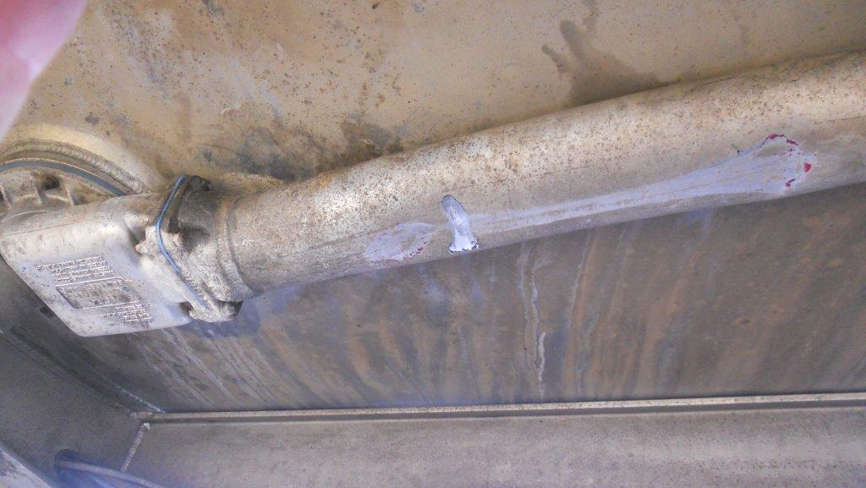
Notes:
Eastlakes rollover on 18 August 16
5000L escaped, cleanup estimated to exceed $1M
Undertanker pipework found to be damaged and leaking, 2nd crew to drain pipework and found 4200 L remaining in tankers
Considering lessons for procedures

Slide 6
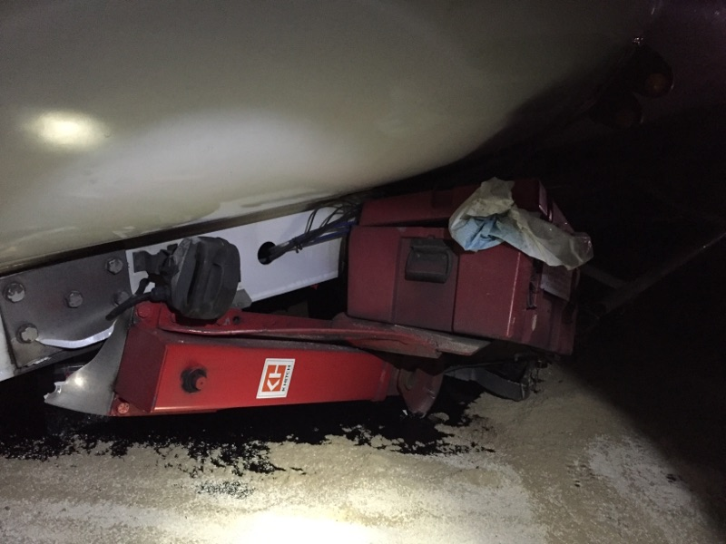
Notes:
Tanker decouple from prime mover on M1 – first compartment breached. Luckily transporting heavy fuel oil not petrol at the time of incident
Maintenance of spring in turntable suspected to have contributed to incident.

Slide 7
Joint roadside compliance
Joint operations with RMS and Police
Training of Highway Patrol – especially the Joint Traffic Task Force
undertake many DG compliance inspections,
issue penalty notices where appropriate with technical advice from EPA
EPA investigates where breaches appear to relate to industry sector or group
Cross-border, inc with SafeWork Victoria
NSW EPA follows up to ensure compliance improvements
Notes:
Compliance efforts covering DG tankers included:
Eg Port Botany, Marulan with RMS, Police
Mobile roadside with Highway Patrol
Depot inspections

Slide 8
Maintaining Safety in (Older) Tankers Project
Continued identification of significant safety related breaches on DG Tanker vehicles
RMS continue roadworthiness inspections of tankers
EPA focus is on safety critical compliance in relation to the tanker itself (product containment etc)
Every compliance operation has identified condition non-compliances in DG Tankers
Notes:
Joint compliance work with RMS identifies systematic condition issues in fuel tankers – roadworthiness, maintenance and compliance with ADG Code/AS2809
Critical safety items like tank closures, drive away protection, leaks and cracks and tank suitability
EPA obliged to increase attention on addressing tanker vehicle condition issues in more systematic way

Slide 9
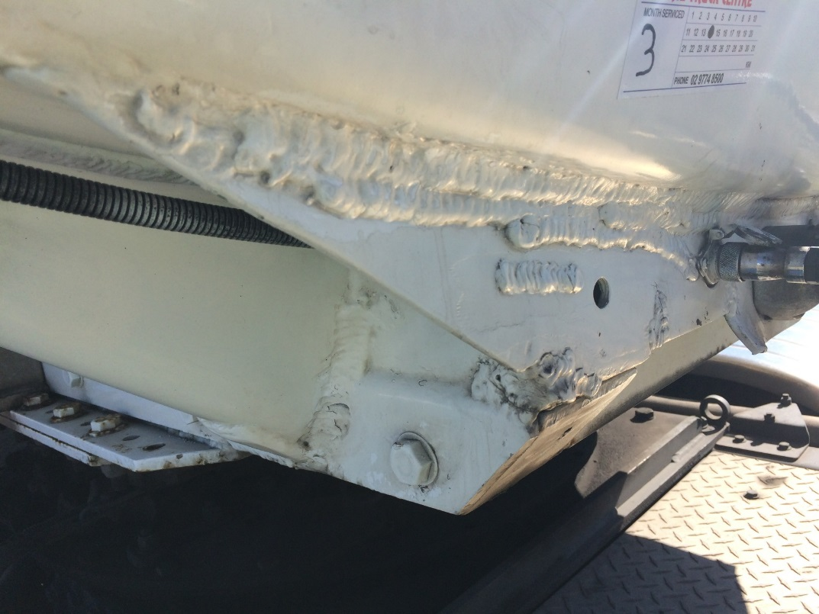
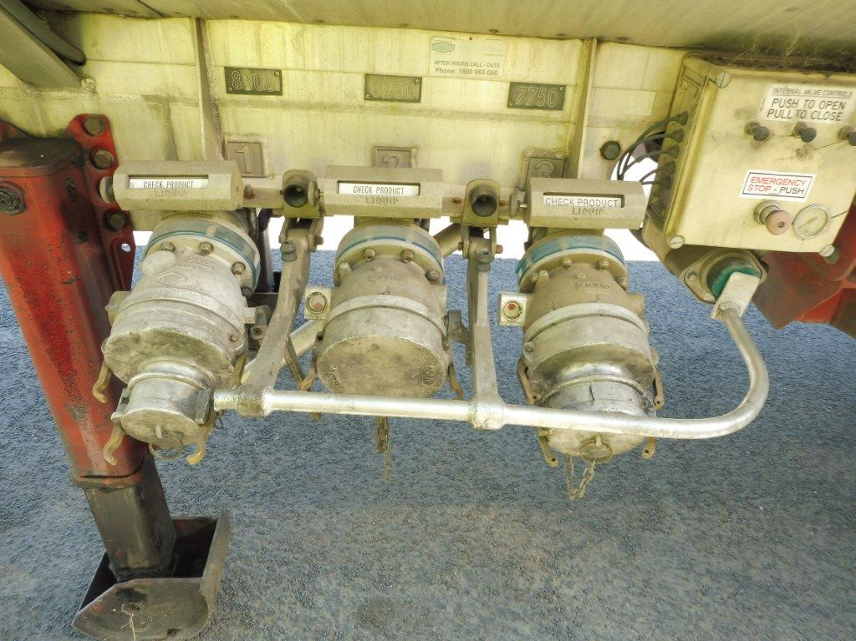
Notes:
Structural corrosion under a tanker
Questionable welds
Driveaway protection bypassed

Slide 10
Moving to mandated periodic assessment
Every tanker should undergo a comprehensive compliance, condition and safety assessment every 5 years
Assessment undertaken by a recognised expert in accordance with Code, AS2809 and referred to standards
A pilot project to trial tanker assessments is due to commence in coming months
CAP support, working with WorkSafe Vic
Notes:
Ensuring periodic checking of vehicles should reduce the reliance on random compliance operations

Slide 11
Review of Prohibited Routes Legislation
Providing more clarity as to what vehicles can’t use prohibited routes (Tunnels), with RMS
Proposing that the breaches mirror those that apply to over height vehicles
Improved signage and publicity to transport industry

Slide 12
Notes:
New signage will look similar to prohibited routed signs in Victoria

Slide 13
Stability control determinations
Stability control required on new dangerous goods tank trailers used in NSW manufactured from July 2014
Roll-over stability control for all dangerous goods tank trailers from 1st January 2019
All tank trailers GVM greater than 4.5 tonnes inc. semi-trailers, B-Double trailers and dog trailers

