Slide 1
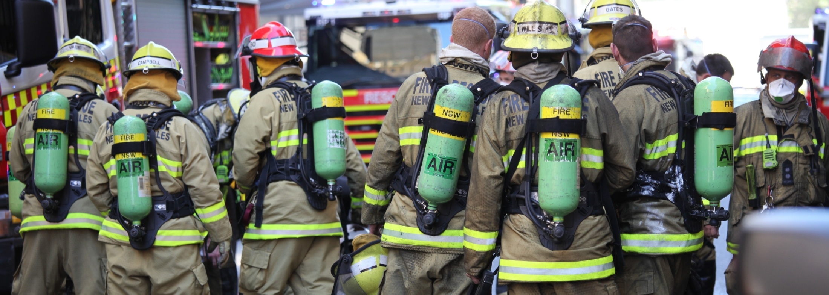
Bulk Tanker Day 2014
Rob McNeil

Slide 2
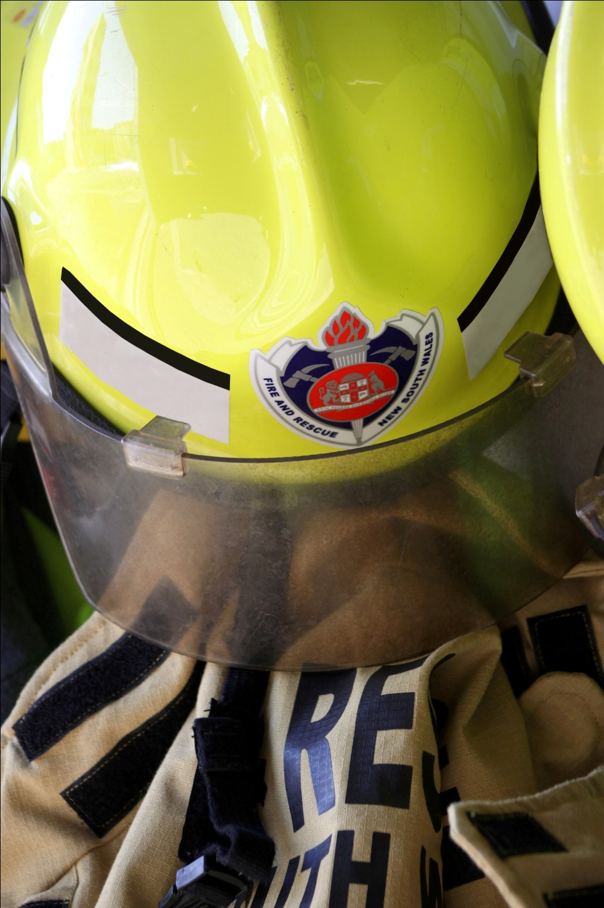
Transport Events Impacting on the Community Overview
Tragic Events Keep Happening
Impact on the Community
Community expectations
What are EM services doing
Tanker Recovery Near Miss

Slide 3
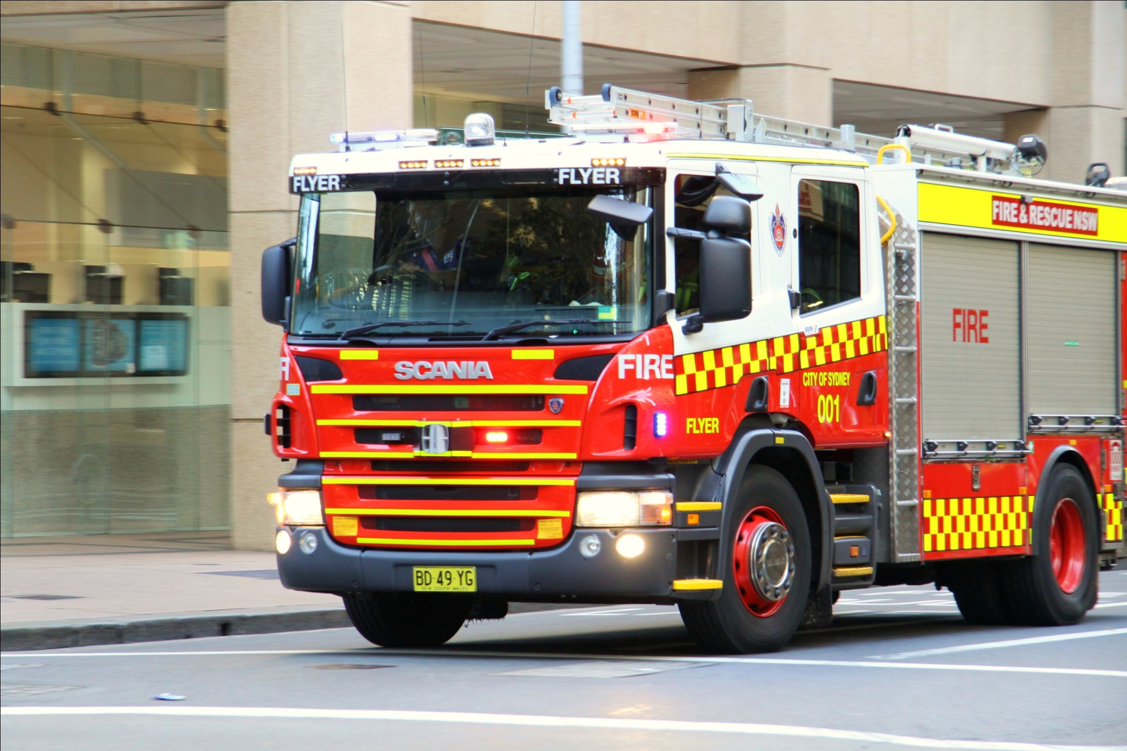
Tragic Events Keep Happening

Slide 4
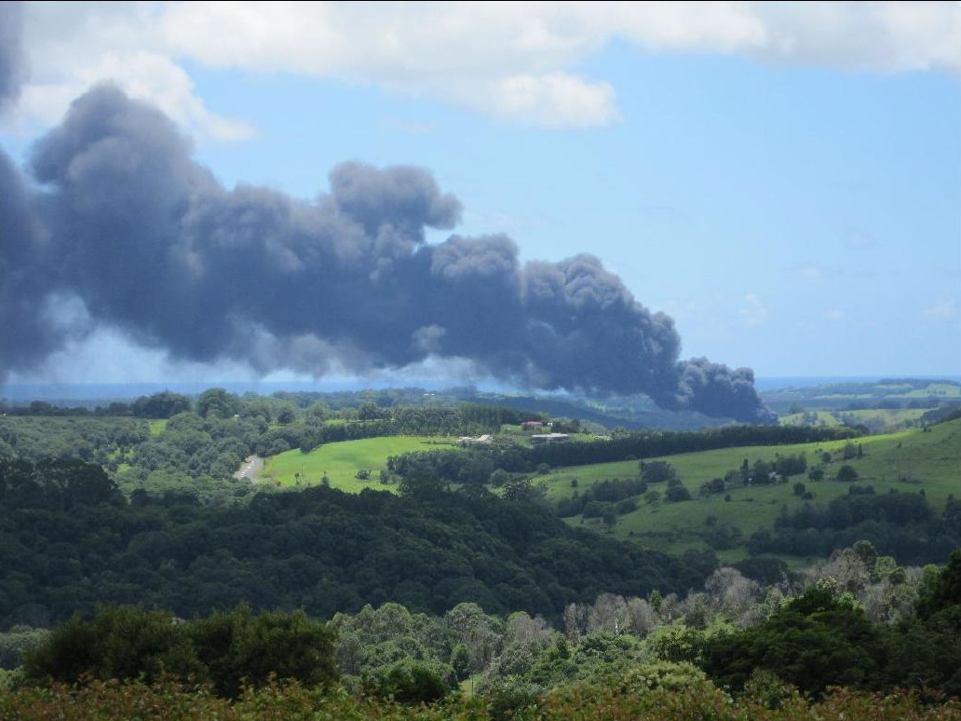
The Impact
Unsettles the communities feeling of being safe
Impact on all emergency services
Events impact on transport routes
Industry is effected.
Notes:
4
Tintenbar Tanker incident

Slide 5
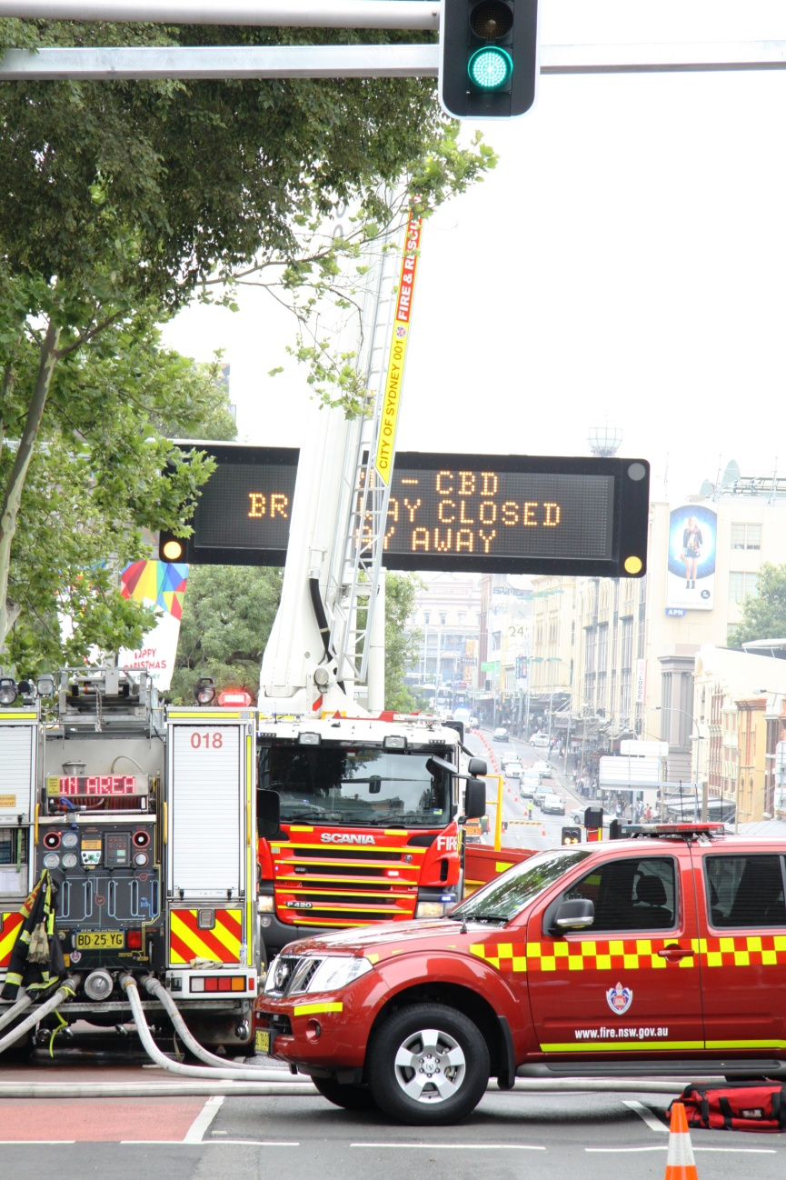
Unsettling Communities & Industry
The Impact goes right across the community
Mona Vale incident happened just after school was out
Within a built up community
Near other industry
Major impact on transport routes
Incidents keep happening
Notes:
5

Slide 6
What Have Emergency Services Done
Incidents involving trucks are that frequent and have such an impact we have changed the way we do business:
As soon as an incident is on a major transport route we send a Liaison Officer to the Traffic Management Centre
Police link in with media outlets to ensure the community is informed.
All our Senior Officers (Duty Commanders) are undertaking TISC Emergency Management decanting course
AFAC has partnered with NBTA & CROIERG to improve and standardise operations.
Our Standard Operational Guidelines have been developed for truck firefighting to ensure we have every opportunity to roll the truck / tanker off the road instead of craning it off.
Notes:
6

Slide 7
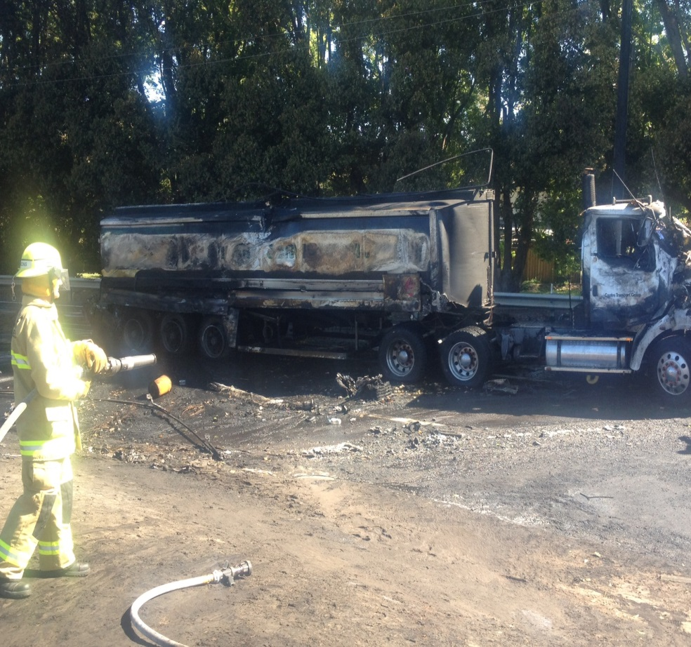
How Will Change be Brought About
What is the impact across the industry
Who will lead the Change
Who should lead the change
Notes:
7
Why Does the industry exist: to provide goods to the community
How does it do this; Safely, effectively and efficiently.
What does it do moves product.

Slide 8
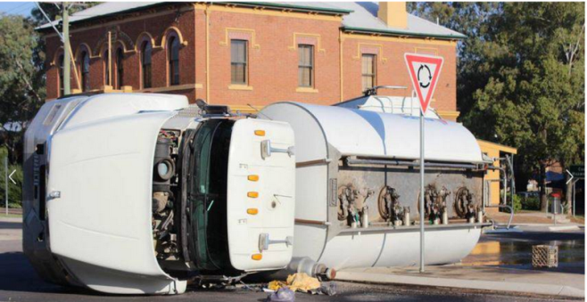
Operational Update on Decanting Operations
On 14 Jan 2014 at 0714hrs tanker roller over in Mudgee
Combination rigid dog-trailer fuel tanker carrying 15000l of diesel (combustible).
Whilst making a right hand turn around the roundabout rigid portion of the tanker rolled leaving the dog trailer upright.

Slide 9
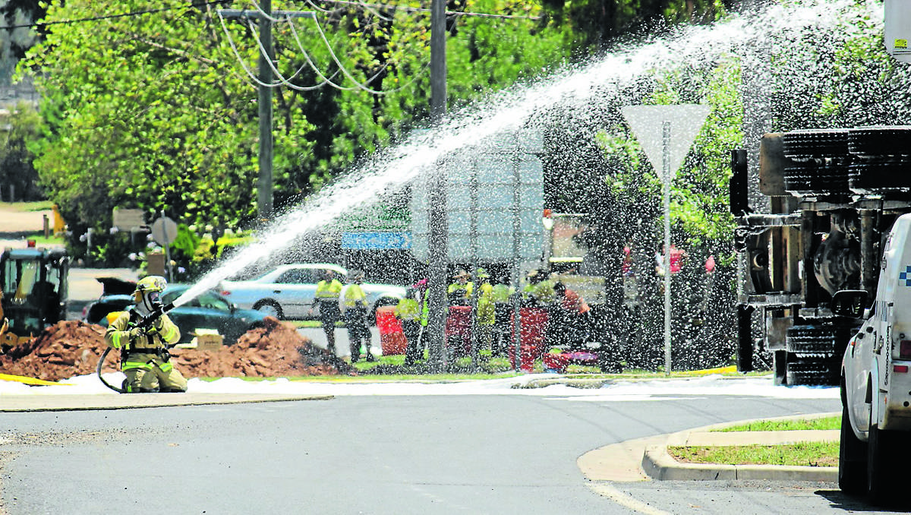
Decanting Operations Case Study
Driver was uninjured.
Diesel was running down the drains.
Bund was created.
Recovery operations commenced
Recovery team splash filled.
Compartment flashed creating a jet flame 20 – 30 metres in the air resulting in superficial burn injuries to the decanting person
FRNSW received nine Near Miss Notifications

Slide 10
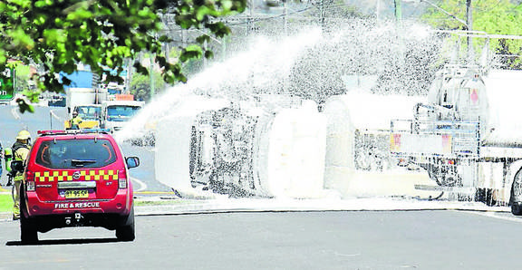
Decanting Operations Case Study
Findings:
Splash filling, not sufficient bonding
Sustained training within FRNSW
Appropriately skilled recovery teams
Recommendations Yet to be handed down
Possible outcomes:
FRNSW IC required to have a decanting controllers card
FRNSW insist on trained recovery teams along with safe practices
Clean tankers
Safe procedures
Qualified Recovery Teams

