Slide 1
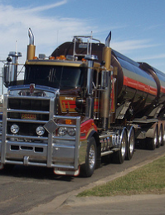
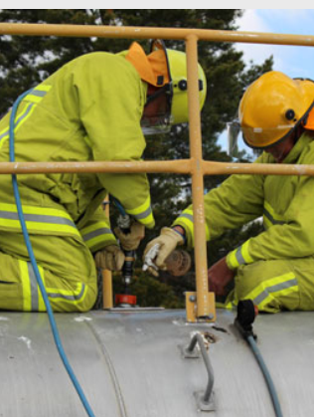
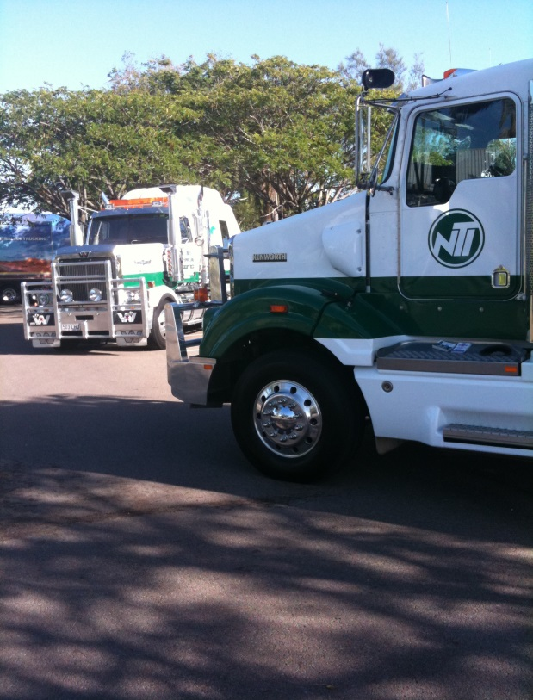
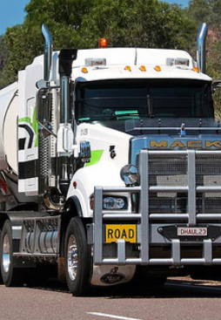
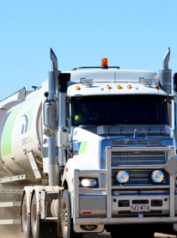
Australian HV Investigation Report
Owen Driscoll National Manager Industry Relations for NTI,
National Director of Research
National Truck Accident Research Centre (NTARC)

Slide 2
BULK DG FREIGHT
Program snapshot over $50,000 research
FREIGHT TASK 6.5%
ACCIDENT / CLAIMS PERFORMANCE 3.5% loss share
ALL UNITS INC. RATE 2.4 / ‘000 / AVERAGE LOSS $130,600
FUEL / OIL BULK RATE 1.3 / ‘000
$246,000

Slide 3
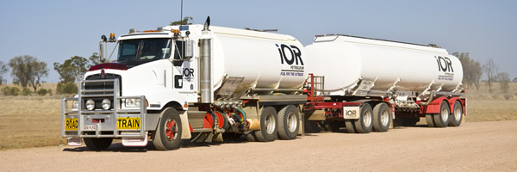
Crash Australia DG bulk
65%
46.3 years
41.1%
90%
80%
inappropriate speed for the conditions
Marginally older.
Experience Average
14.36 years
B – Double
Configuration
Outbound & Loaded.
Single Vehicle
Incidents

Slide 4
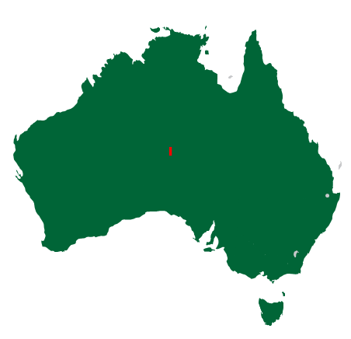
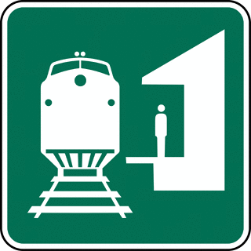
Growth in task Vs crash incidents
Road Transport Industry – 195,619 mltk.
National Road Freight Task
35%
road freight task
Road freight task grown to
2,132
49%
rail freight task
80% coal/iron ore
million tonnes

Slide 5
NATIONAL SNAPSHOT Over $5k (ROAD FREIGHT 2011 - 2015)
STATE | LOSSES ($) | LOSSES Nos. | AVERAGE $ | SVA | MULTIPLE | STRIKE RATE Losses per insured items.
QUEENSLAND | $144.05M | 3379 | $42,406 | 47.2% | 53.1% | 1:41.6
SOUTH AUSTRALIA | $42.78M | 1452 | $29,462 | 46.1% | 53.9% | 1:41.3
VICTORIA | $84.65M | 3158 | $26,806 | 35.1% | 64.9% | 1:30.7
TASMANIA | $11.6M | 399 | $29,212 | 56.9% | 43.1% | 1:56.5
NORTHERN TERRITORY | $12.44M | 265 | $46,974 | 66.4% | 33.6% | 1:65.7
WESTERN AUSTRALIA | $85.9M | 2089 | $41,134 | 55.7% | 44.3% | 1:47.6
NEW SOUTH WALES | $101.8 | 3188 | $31,878 | 37.8% | 62.2% | 1:37.4
 | $483.22M | 13,930 | $34,689 | 44.1% | 55.9% | 1:40

Slide 6
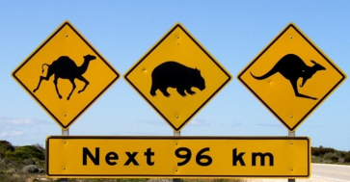
Crash Australia 2016
Summary of findings (sva’s : 44.1%)
14.4%
7.4%
5.9%
7.3%
7.2%
inappropriate speed for the conditions
Fatigue related truck crashes.
Non-impact fire losses. Remains a concern
of the time the heavy vehicle rolled whilst tipping
Attributed to mechanical failure
(Inc.)
TYRE FAILURE
& FIRE
Animal strike 14.4%

Slide 8
MULTI VEHICLE ACCIDENTS 56% : STATE / FINDING

Slide 9
MAINTENANCE 7%: STATE / FINDING

Slide 10
Crash Australia 2015
Summary of findings - MULTI-VEHICLE COLLISIONS (55.9%)
68.4%
7.9%
34%
11.1%
10%
Reversing
unsafely
Hit Third Party vehicle
in the rear.
Failed to give way
to third party vehicle.
Struck parked vehicle
of the time the heavy vehicle was at fault in a multi-vehicle collisions
14.1%
Liable when changing lanes

Slide 11
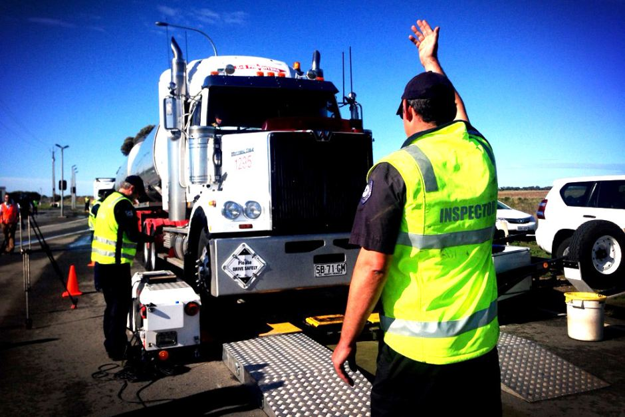
Crash Australia 2016
Summary of findings MECHANICAL (7.2%)
32.6%
16.8%
7.3%
20.7%
1.2%
Turntable / hoist failure – incorrect
coupling, wear & tear.
Wheel security /
Bearing failure
FIRE – Mechanical / Electrical.
BRAKE / Steer failure.
Tyre Failure due to over / under inflation, heat, road conditions, defects etc.

Slide 12
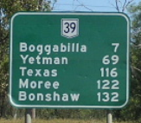
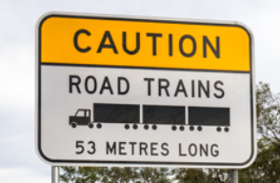
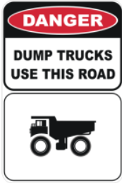
Crash Australia 2016
Summary of findings : ROAD REFERENCE
38.4%
23.6%
12.3%
2.6%
23.1%
Regional road
network NON Highway
Remote Areas.
OFF Network
Mining / Off-road /
Building Sites.
Miscellaneous Highways
URBAN / METROPOLITAN road network

Slide 13
Accident specifics
Time of day

Slide 14
Accident specifics
Driver’s age
Average age 45 years 248 days
69.6%
1 in 4.2
of drivers were over 40 years of age.
are over 55 years old
4.1% UNDER 25.
There has been an increase in incidents involving drivers over 50 years of age. (40.1% of losses)

Slide 15
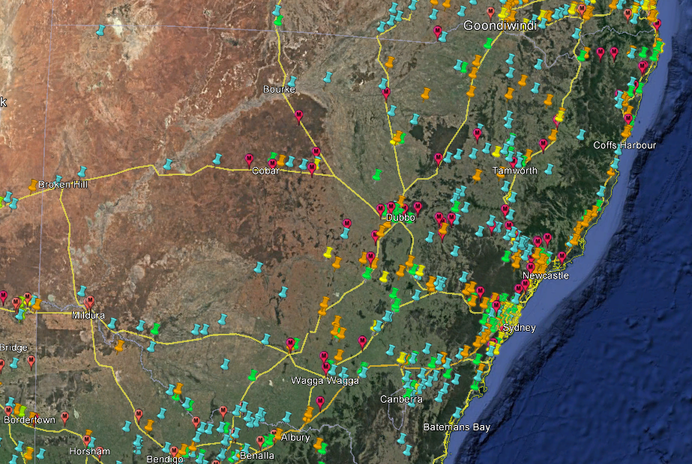
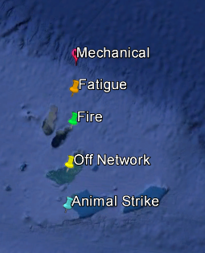

Slide 16
