Slide 1
Heavy Vehicle Roadworthiness Program
Bulk Tanker Day 2014
Paul Retter, Chief Executive and Commissioner
4 September 2014

Slide 2
NTC and NHVR roadworthiness program
Two streams of work:
A review of heavy vehicle roadworthiness inspection regimes
A review of the national heavy vehicle accreditation scheme or NHVAS.
Aim is to improve heavy vehicle roadworthiness in order to reduce the number of fatalities and serious injuries on our roads and support efforts to improve community confidence in heavy vehicle safety.

Slide 3
More effective national roadworthiness regime will involve…
developing nationally consistent standards and approaches
identifying the most effective use of accreditation schemes
ensuring that all legislative provisions, governance arrangements, and operational requirements are appropriately designed and sufficiently robust
ensuring that costs to industry and governments are minimised.

Slide 4
Current progress
Phase 1 report examined our current roadworthiness system and associated practices
Phase 2 report identifies opportunities for improvement
Open for public submissions until 26 September

Slide 5
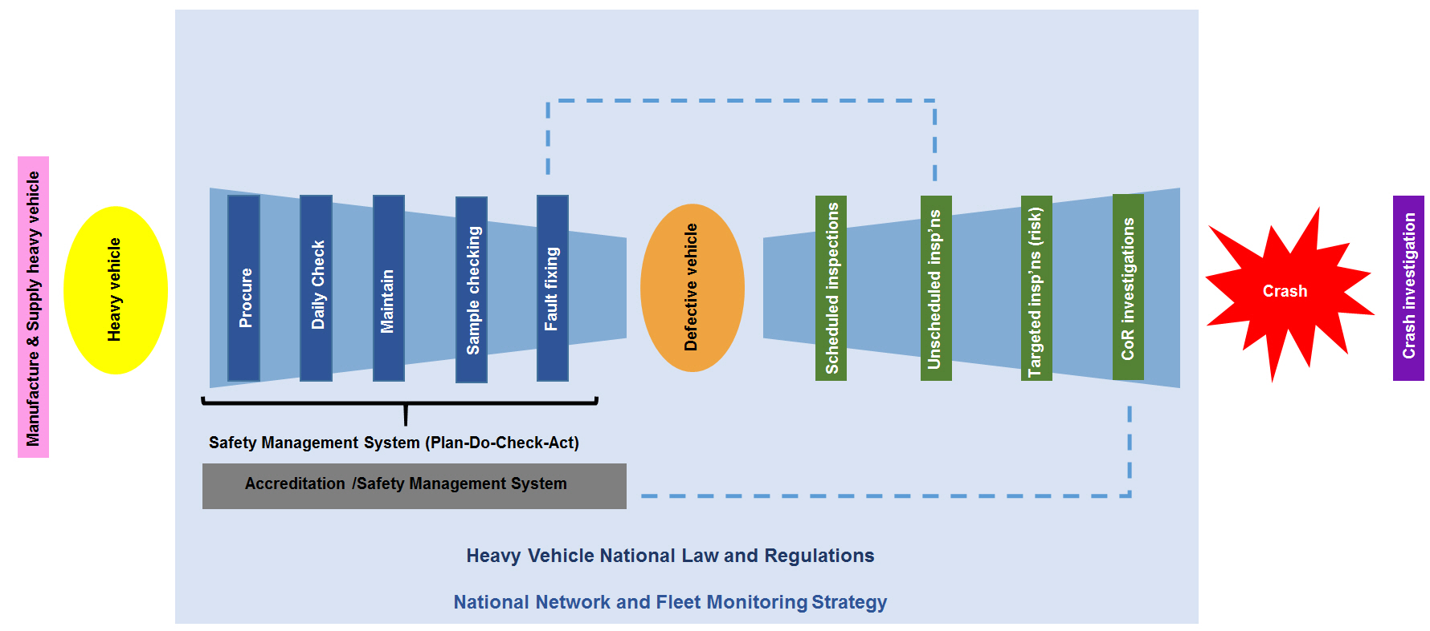
“Bow tie” model

Slide 6
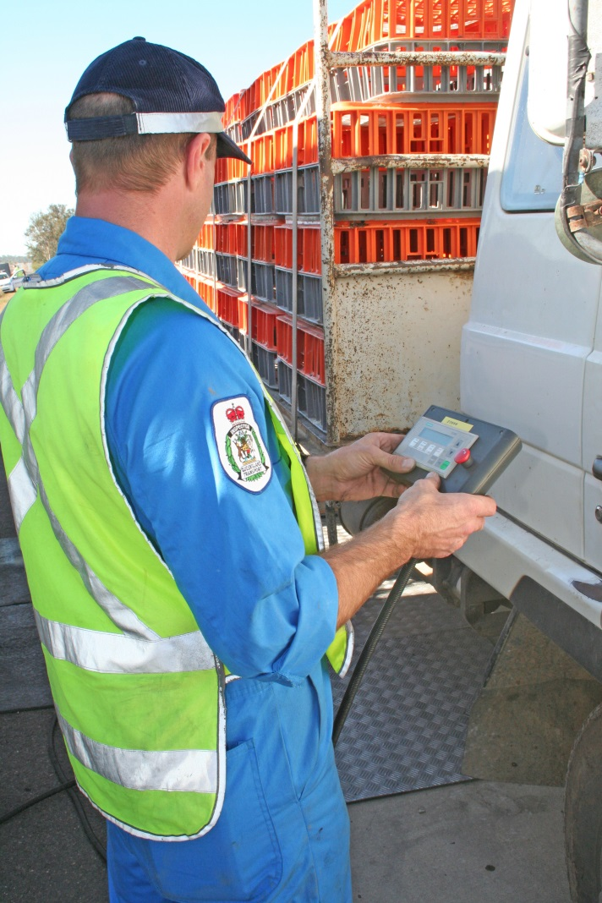
Opportunities for improvement
A clear definition of what constitutes roadworthiness under the Heavy Vehicle National Law.

Slide 7
Opportunities for improvement
Better information, education and training

Slide 8
Opportunities for improvement
Exploring how chain of responsibility duties could apply to vehicle roadworthiness.

Slide 9
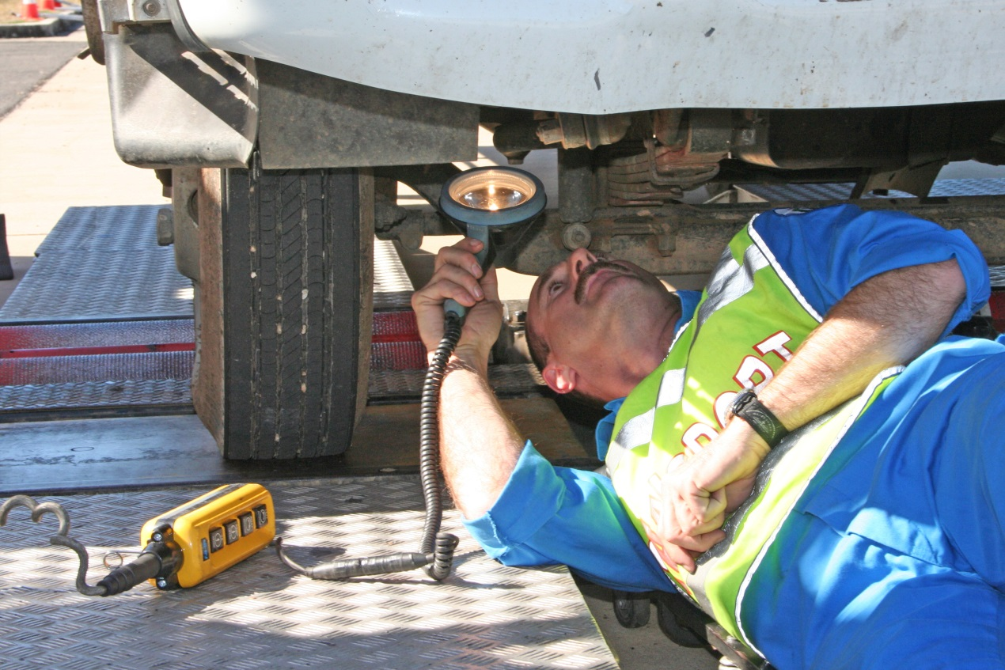
Opportunities for improvement
A standardised second party inspection system.

Slide 10
Opportunities for improvement
Improved accreditation/safety management system arrangements

Slide 11
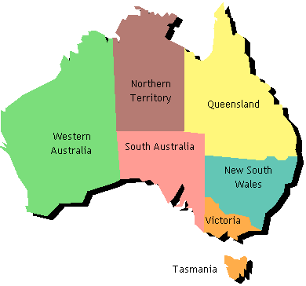
Opportunities for improvement
Establishing a nationally consistent network and fleet monitoring strategy

Slide 12
Australian Dangerous Goods Code
New edition 7.3 August 2014
Available to download from the NTC website at www.ntc.gov.au

Slide 13
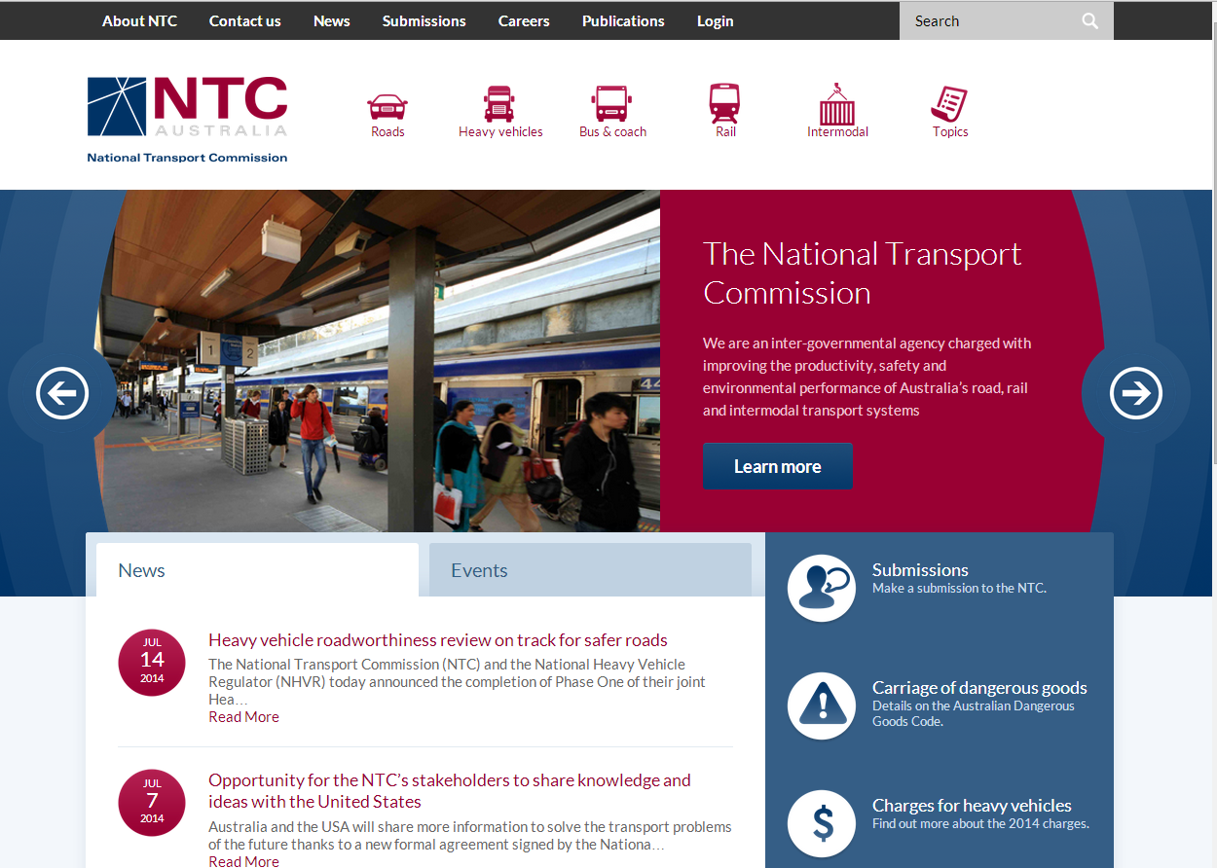
New NTC website
www.ntc.gov.au
Use on smart phones and tablets
Easier to find information
Tailor news to your interests
An advanced search feature
A better submissions process

Slide 14
The National Transport Commission leads regulatory and operational reform nationally to meet the needs of transport users and the broader community for safe, efficient and sustainable land transport.
Keep in touch with the latest NTC news by registering to receive our free e-newsletter and alerts at www.ntc.gov.au

