Slide 1
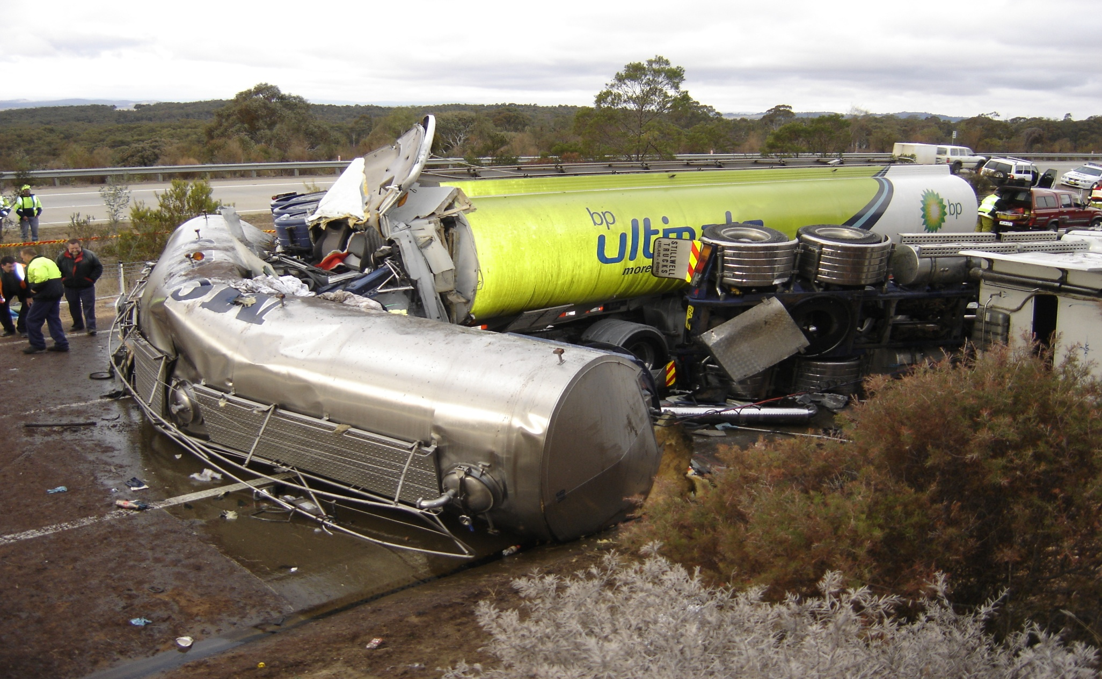
TERP Governance
TERP Governance
Mark Williams

Slide 2
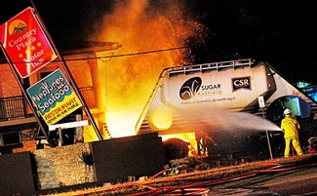
TERP – Survey Results – July 2009
What level is the TERP program at in your business:
- Fully developed 49%
- Partially or desk top only 51%
Practical training exercises
- 62% (Yes)
- 38% (No or don’t know)
At what level is that training at:
- Significant 30%
- Limited or none 70%
Who conducts the training:
- RTO & Others 36%
- Internal Trainer 57%
- No Training 7%
How often is the training updated
- Regularly 35%
- Annually or induction only 65%

Slide 3
Survey Conclusions
Many Operators did not know what their obligations were with regard to TERP requirements
– some conflicting & confusing results
23% do not have a documented TERP
24% believe that their TERP training was “accredited”
49% believe that their system was fully developed
55% not aware of any “specific” TERP training
70% have little or no training in TERP requirements
CONCLUSION: THAT THERE WAS CONSIDERABLE ROOM FOR IMPROVEMENT

Slide 4
CROIERG – TISC – NBTA – AFAC
CROIERG had already developed the TERP Training programs with TISC for Class 3’s
NBTA recognised that training needed to expand to cover most other DG classes
TISC worked with NBTA & developed enhanced training modules for additional DG classes
Training modules completed and AFAC became involved
Training modules recognized as “accredited training”
Governance, controls & “card” coordinated through FPAA

Slide 5
Governance, Administration & Control
Governance Committee
NBTA, CROIERG
TISC, AFAC
Selected
RTO’s
Marketing
Promotion
Designated Trainers
Provision
Training
Equipment
ADMINISTRATION
&
CONTROL (FPAA)
DG
Operators
Nominees
Refresher Training &
Upgrades
Operator
Nominees Accreditation
TERP
Competency “Card”
FPAA
Auditing
Processes

Slide 6
THE ROLE OF FPAA
MATTHEW WRIGHT

