Slide 1
Fire Protection Association Australia
Australia’s major technical and educational fire safety organisation
Membership base that is extremely broad consisting of approximately 1900 Members - both Individual and Corporate.
We represent around 15,000 people employed in the Fire Protection & Safety Industry throughout Australia
National office located in Box Hill, Victoria employing 20 permanent staff
Nationally Registered Training Organisation (RTO)
Government-appointed administrator / implementing agency for Licensing Programs
Cabling Licences (Australia Multimedia Communications Authority) – 3200+ licences issued to date (2 different licence categories)
Extinguishing Agent Handling Licences
Ozone Protection & Synthetic Greenhouse Gas Management Regulations 1995 as it applies to the fire protection industry.
1350+ licences issued to date (6 different licence categories)

Slide 2
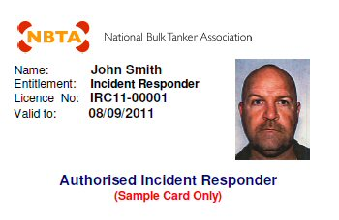
Fire Protection Association Australia
FPAA Australia to act as administrators for issuing and re-issuing of cards under the scheme
Processing of received applications and validation of required competencies to issue card
Maintain database of all licence holders
NBTA will set minimum requirements under the scheme

