Slide 1
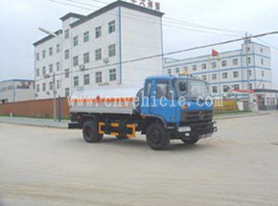
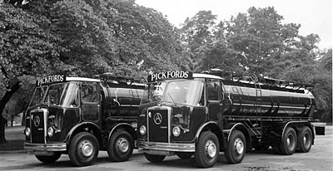
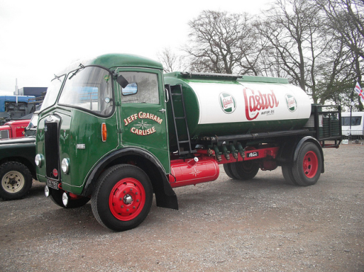
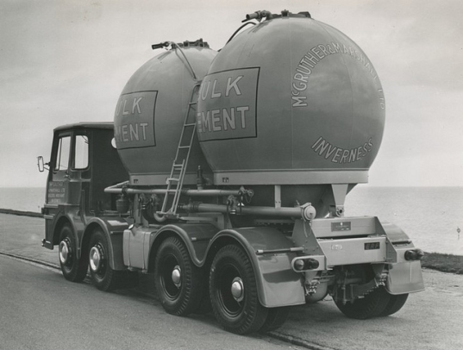
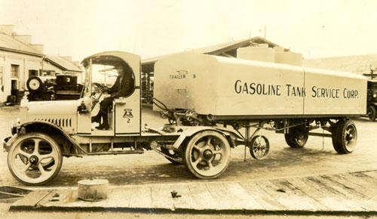
The Changing Industry Structure

Slide 2
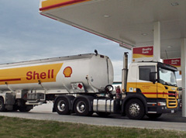
What is the Tanker Industry ?

Slide 3
Changes : More products move in tankers.
Milk
Diesel
Avgas
Canola oils
Chemicals
Water
Tallow
Sugar
Molasses
Diesel
Ethanol
Cement
Lime
PVC
Grain
Plastics
Flour
Fertilizer
Sand
Wine
Must
Latex
Salt
Rice
LPG
CO2
Butene
Butylene
Oxygen
Refrigerant Gas

Slide 4
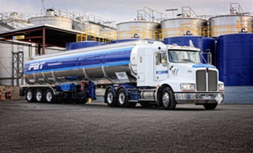
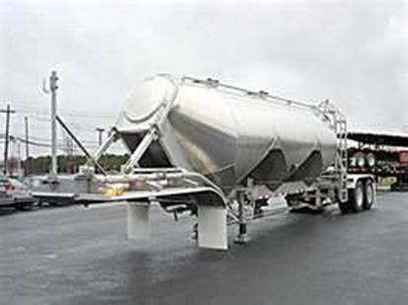
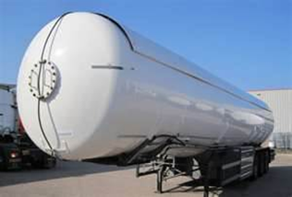
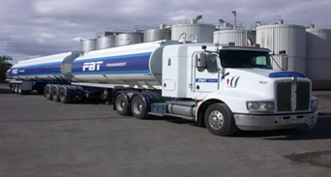
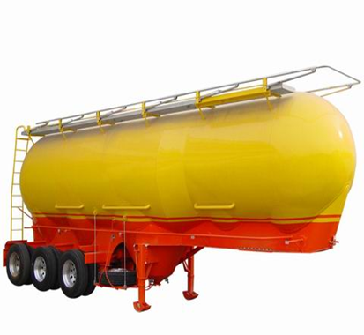
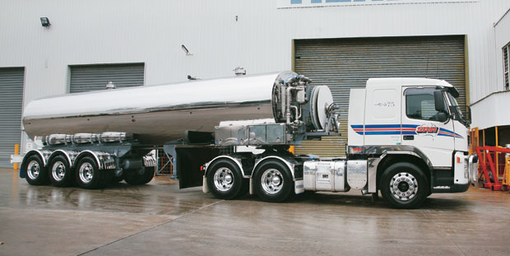
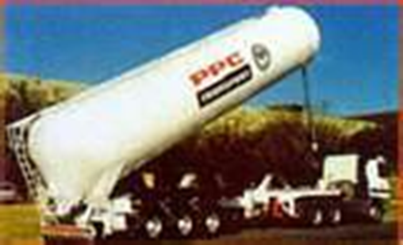
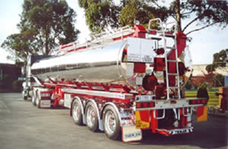
Chan
What is a Tanker ?

Slide 5
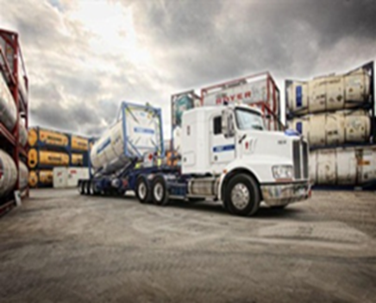
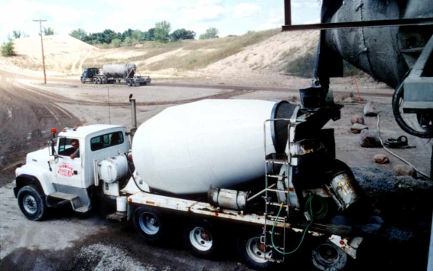
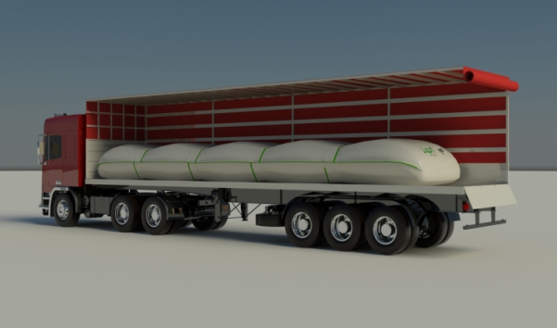
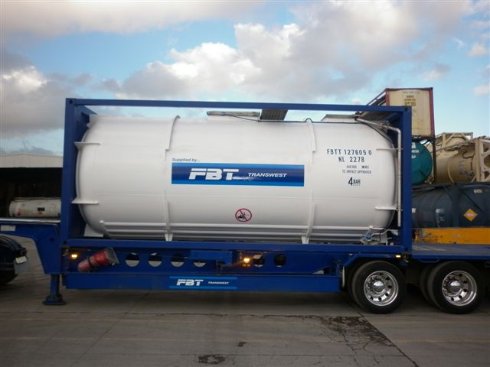
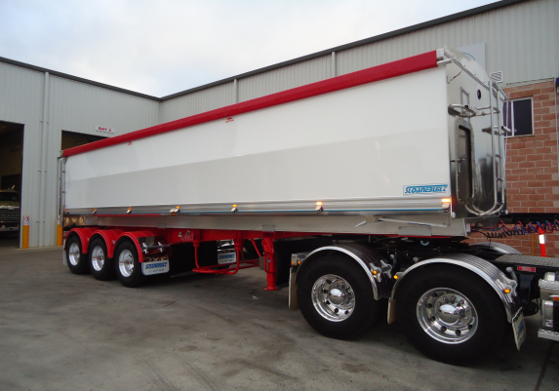
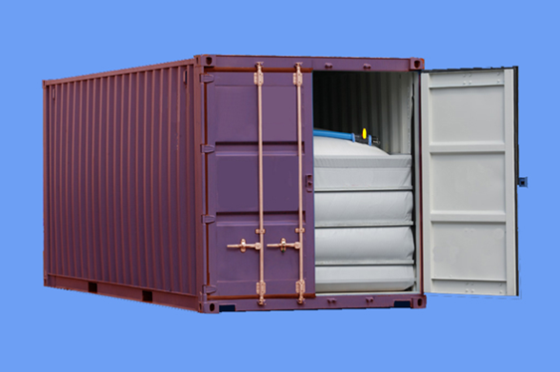
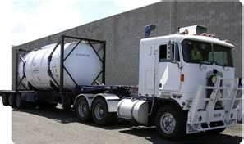
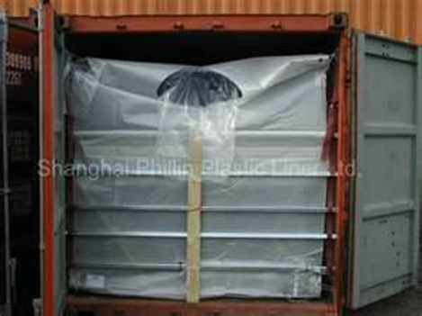
What is a Tanker ?

Slide 6
Changes in the work Environment
Fleet Ownership – Outsourcing
Road Surfaces and technology
Road design - layout changes
Increase in the number of road users
Speed variances
Vehicle changes( Trucks – ride ,auto shift, cruise control,phones etc.)
Load out depots
Unloading Facilities

Slide 7
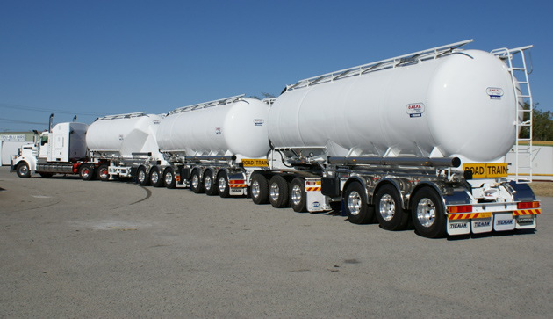
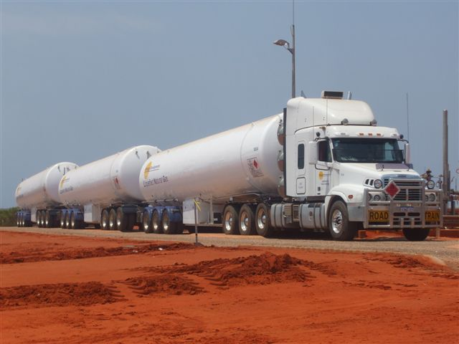
Changes in Safety & Environmental Focus
Inductions
Driver Training
PPE equipment – face shields, gloves ,suits, BA
Hand Rails
Equipment Improvements – ABS,EBS,RSC etc.
Emergency Response Training
Ancillary equipment – Hoses, Fittings and Valves
Spill Kits
Product Awareness
Loading practices – move to bottom loading

Slide 8
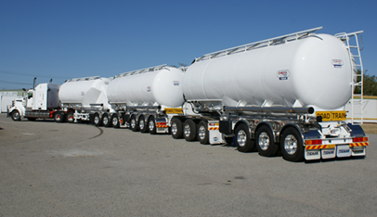
Changes in Legislation / Regulation
Dangerous Goods Legislation
Industry Codes
Driving Hours
Variances Geographically
Combinations
Emergency Response
ADR changes
Chain of Responsibility
Safe Rates
OH&S Act

Slide 9
Knowledge Change/Challenges
Ageing driver workforce
Management
Fleet Control
Enforcement Agencies
Co ordination of Agencies
Geographical Variances
Public Awareness

Slide 10
What will the Future Demand?
Safe
Improved Knowledge at all levels
Low Cost
Efficient
Flexible
Intermodal
Humans will still be required
What goods are not Dangerous?

