Slide 1
TRAILER NETWORK
Paul pulver
chairman

Slide 2
THE FIRST TWO TRAILERS
NOW SOLD – FAR TOO BIG, HEAVY AND NOT SUITABLE

Slide 3
FIRST GO AT A WORKABLE UNIT

Slide 4
ANOTHER VARIATION

Slide 5
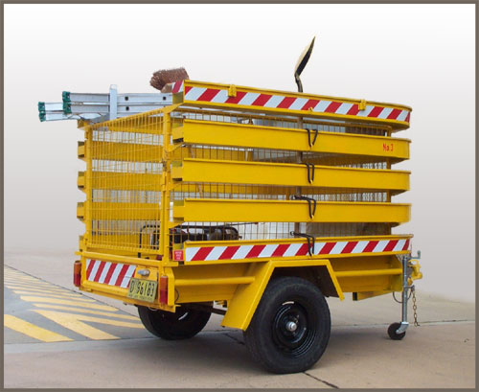
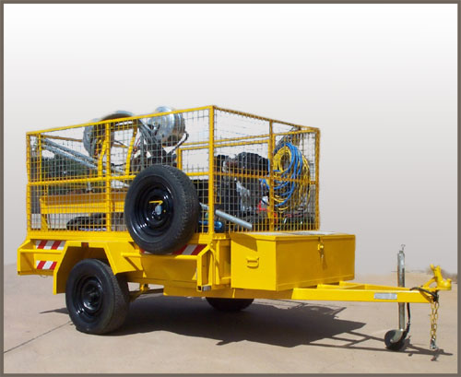
Specialised Units
Skimmer Trailer
Pumping Trailer

Slide 6
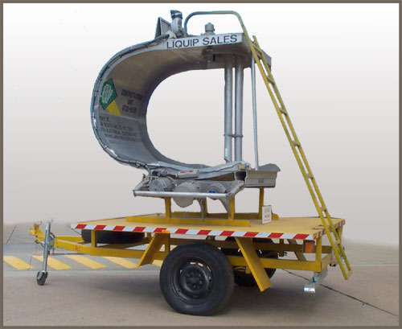
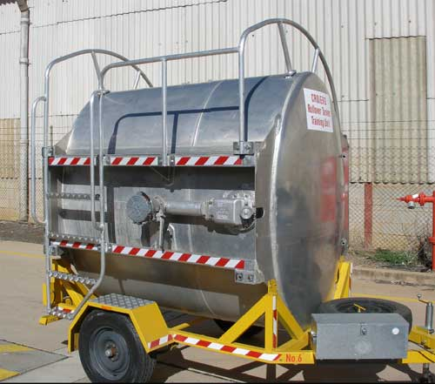
Specialised Training Units
CUTAWAY TRAILER
ROLLOVER TRAILER

Slide 7
TESTING MODIFICATIONS

Slide 8
CURRENT STANDARD UNITS
8’ X 5’ FOUR COMPARTMENTS WITH AIR PUMP

Slide 9
STATIC TRAINING UNIT

Slide 10
The 30 Trailers are based at
7 in Canberra, including 2 Training Units
1 in Cootamundra
1 in Dubbo
1 in Eden
1 in Goulburn
1 in Griffith
1 in Holbrook
1 in Moruya
2 in Newcastle
1 in Orange
1 in Port Kembla
1 in Wagga Wagga
1 in Wauchope
1 in Yass
1 ready to go to Cooma
1 in Benalla (Vic)
1 in Wodonga (Vic)
1 in Shepparton (Vic)
1 in Melbourne (Vic)
1 in Brisbane (Qld)
1 in Emerald (Qld)
2 now in production for Sydney
Additional back-up supples are based in Canberra, Dubbo & Shepparton

Slide 11
What’s ahead?
CROIERG is now concentrating on:
Extending the trailer network
Bringing older trailer units to a higher standard
THANK YOU

